Slide 1
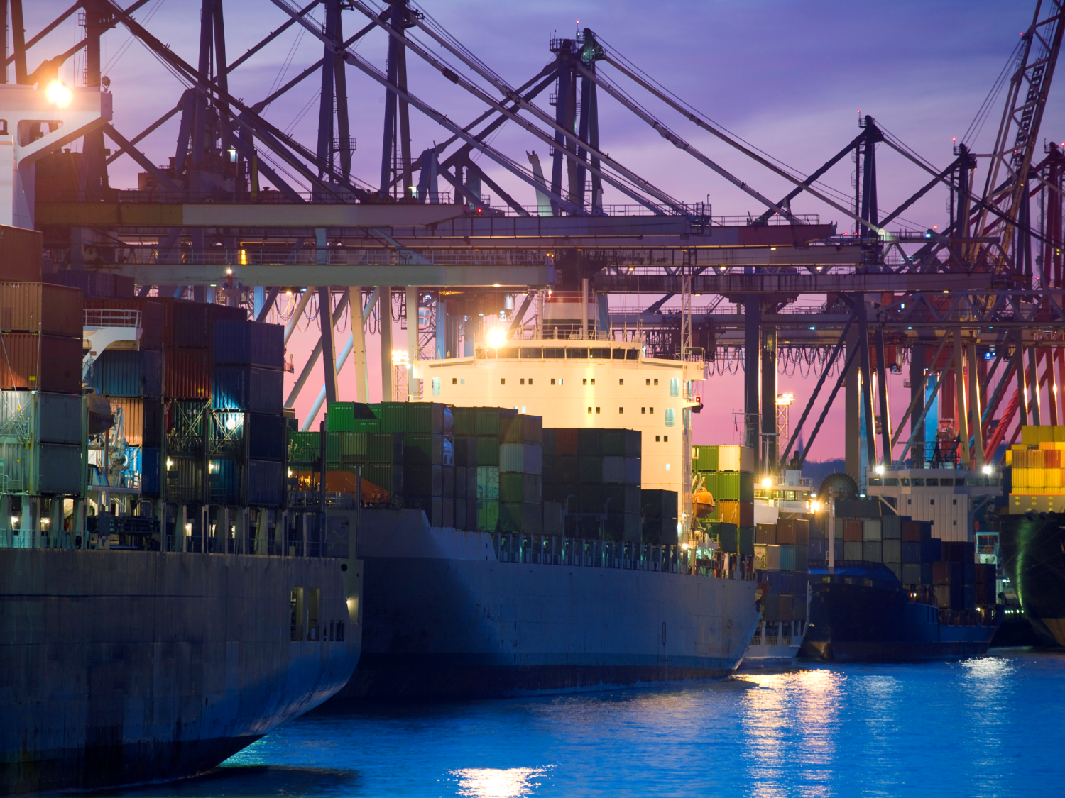
Flanders & Kocaeli
as business partners
Raphael Pauwels
Flanders Investment & Trade
25 November 2014
Notes:
On behalf of Flanders Investment & Trade, an agency of the government of Flanders, the northern region of Belgium, I want to thank the Chamber of Commerce of Kocaeli for giving me the opportunity to present our region here today.

Slide 2
Flanders ?
Notes:
To clarify your idea of Flanders, let me just give you a few examples of companies from Flanders that you may know.

Slide 3
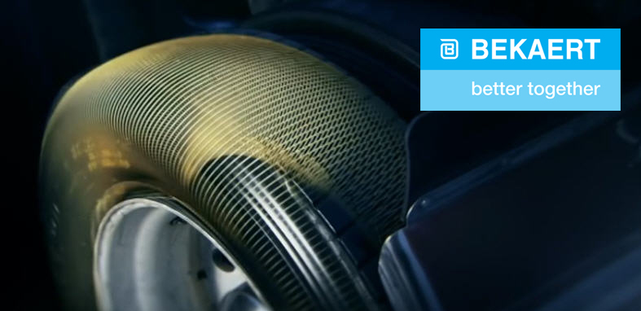
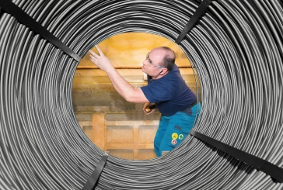
Flanders… in your tyres and buildings
Bekaert
Steel cord and wire for tyres and construction.
Plant in Izmit. (ex BekSA))
Notes:
The biggest investments from Flanders in Turkey, are here in your province, Kocaeli. The Bekaert plant in Izmit for instance, counts around 600 employees, and has recently acquired part of the Pirelli activities, and with that also hundreds of extra employees

Slide 4

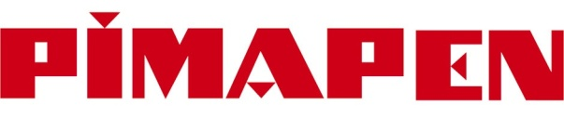


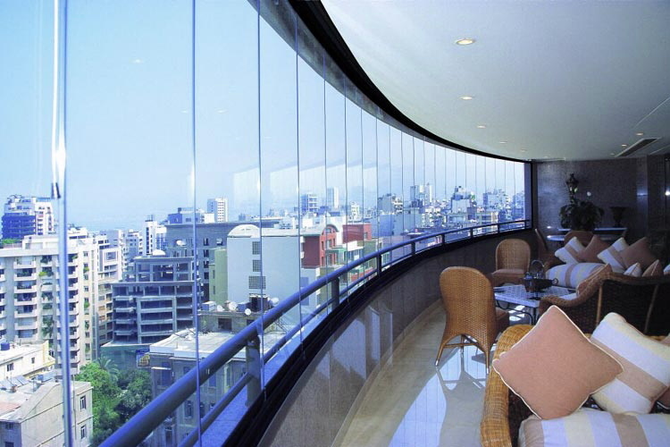
Flanders… in your houses
Pimapen,
Egepen,
WinSA.
Window profiles
and systems.
Part of Flemish group
Deceuninck.
Factories in Kocaeli,
Izmir and Adapazari.
Number one on the Turkish market.
Notes:
Deceuninck is well known to you as well, I believe?
Most of you probably know the name, have seen the logo, but didn’t know it was a group from Flanders.
Well it is.
Egepen, Turkey’s market leader in window profiles and systems, is part of this group, that also owns the Winsa brand, and has recently also acquired Pimas, the Kocaeli company with the Pimapen brand. Deceuninck is now by far the number one on the Turkish market.

Slide 5

Flanders… for your baby
Astel / Ontex :
Producer of
hygienic disposables.
Subsidiary of the
Flemish group Ontex.
Factory in Istanbul.
Notes:
The baby diaper brand Canbebe may also be known to you, at least if you have young children.
It’s a brand of the Turkish company Astel, which is part of the Ontex group, with headquarters in Flanders.

Slide 6
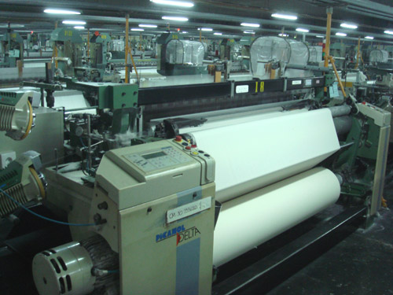
Flanders… in your factories
Picanol &
Van de Wiele
World famous
textile machines
omnipresent in
Turkish textile factories.
Notes:
And to people with an industrial background, and especially the people from the textile sector, the names of Picanol and Van de Wiele will be very familiar. Their machines have laid the basis for the boom of the Turkish textile production.

Slide 7
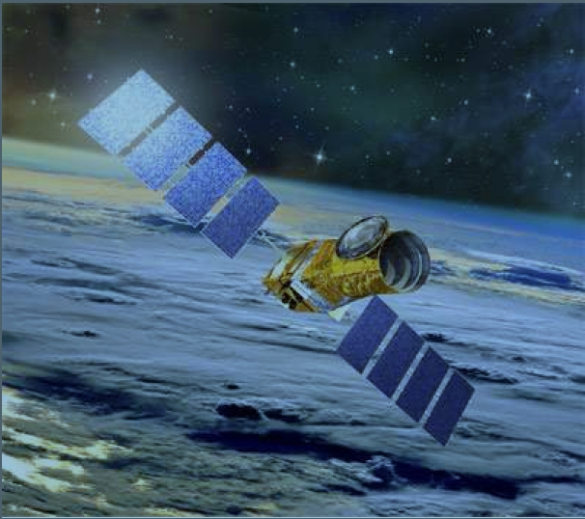
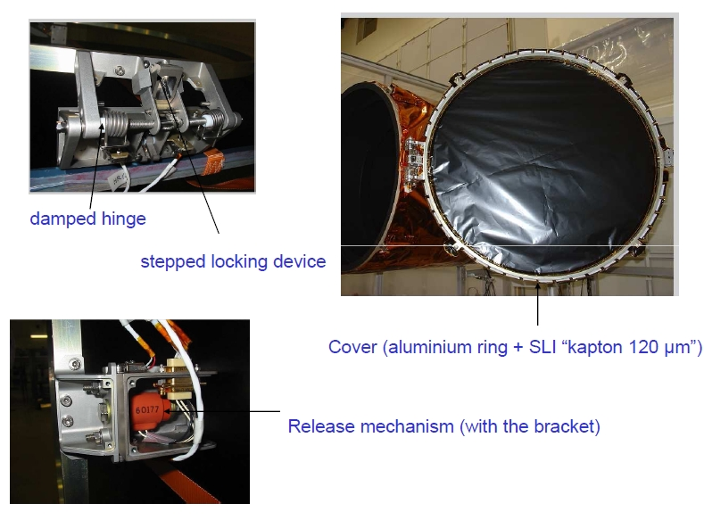
Flanders… in Turkey’s satellites
Technology
Verhaert/Qinetiq:
Supplier of parts for
Turksat satellites
Notes:
Even in Turkey’s most advanced technological ventures, like the Turksat satellites, knowhow and technology from Flanders is present, with some of the parts for these satellites being supplied by the company Verhaert/Qinetiq.

Slide 8
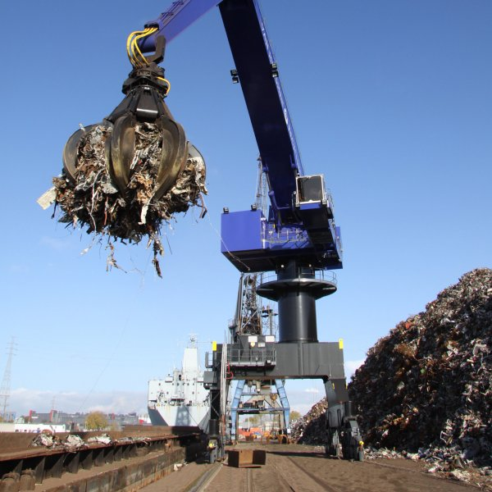
Flanders… in Turkey’s steel factories
Group Galloo,
BST
Huge volumes of scrap metal
go from Flanders
to Turkey’s steel factories.
Notes:
But we”re not only in hightech. We also do huge volumes in scrap metal traffic to Turkey.

Slide 9
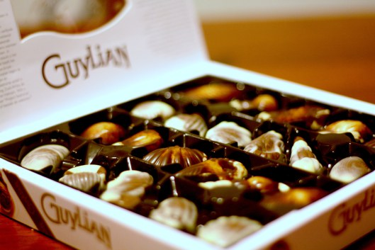
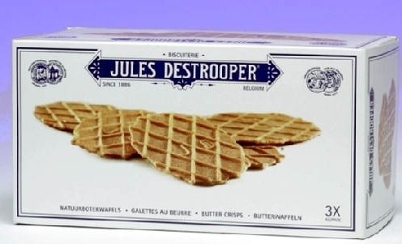
Flanders… for fine tasting
Belgian chocolates
(and much more)
Chocolates, biscuits,
filter coffee,
snacks & sauces,
soy milk drinks etc.
In your supermarkets.

Slide 10
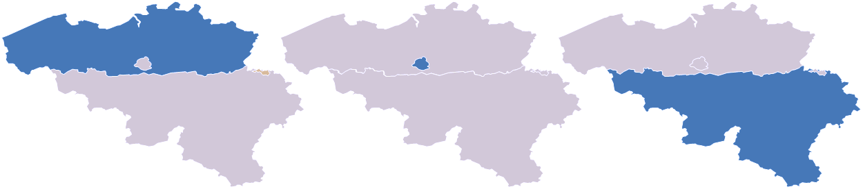
What & where is Flanders?
Flanders Region
58% of population
82,5% of Belgian exports
84,3% of Belgian imports
Brussels Capital
10% of population
2,4% of Belgian exports
4,0% of Belgian imports
Walloon Region
32% of population
15,1% of Belgian exports
11,7% of Belgian imports
Source : Belgian National Accounts Institute, community concept, 1H14
Notes:
As you can see, Flanders is the northern region of Belgium
It counts nearly 58 % of the total Belgian population.
It accounts for 82,5% of Belgian exports of goods.
AND, more important for you : it stands for 84,3% of Belgian imports of goods
(These are figures for the 1st half of 2014).

Slide 11
Belgian imports from Turkey
TR --> BE | Value (million EUR) |  |  | Share
 | 2013 | 2012 | 2011 | 2013
Flanders | 2 693,4 | 2 760,5 | 2 827,3 | 83,22%
Wallonia | 314,6 | 260,8 | 285,7 | 9,72%
Brussels | 228,4 | 95,0 | 53,0 | 7,06%
TOTAL BELGIUM | 3 236,4 | 3 116,3 | 3 166,1 | 100%
(source : National Bank of Belgium)
Notes:
Now if we look specifically at the trade between Belgium and Turkey, we see that in Turkish exports to Belgium Flanders takes more that 83%.
The other way around, the figure is even higher : if you look at Turkish Belgian exports to Turkey, the share of Flanders is higher than 90 %.
But I will not go into the details of that, because that is not the purpose of this meeting.

Slide 12
From Turkey to Flanders (2013)
(in % of total)

Slide 13
Imports (Turkey -> Flanders)
2013 : € 2,69 bn (incl. transit) -2,43%
        - 0,94% of total imports in Flanders
            (was 0,77% in 2008)
1H2014 : € 1,49 bn +7,90%
        - 1,03% of total imports in Flanders
Imports more than tripled since 2002
Turkey = 17th supplier of Flanders (in 1H14)
(was 21st in 2008)

Slide 14
Belgian exports to Turkey
BE --> TR | Value (milllion EUR) |  |  | Share
 | 2013 | 2012 | 2011 | 2013
Flanders | 4 226,7 | 4.098,3 | 4.175,8 | 90,67%
Wallonia | 411,0 | 428,1 | 518,2 | 8,82%
Brussels | 23,7 | 30,8 | 25,1 | 0,51%
TOTAL BELGIUM | 4 661,5 | 4.557,2 | 4.719,1 | 100%
(source : National Bank of Belgium)

Slide 15
From Flanders to Turkey (2013)
(in % of total)

Slide 16
Exports (Flanders -> Turkey)
2013 : € 4,23 bn (incl. transit) + 3,13%
        - 1,44% of total Flemish exports
              (was 1,21% in 2008)
  1H2014 : € 2,26 bn + 5,51%
        - 1,54% of total Flemish exports
Exports +/- tripled since 2002.
Turkey = 11th export destination of Flanders (in 1H14)
  (was 15th in 2008)

Slide 17
Turkey in Flanders
Notes:
We’ve already talked about Flanders presence in Turkey; Now let’s look at Turkish companies’ presence in Flanders

Slide 18
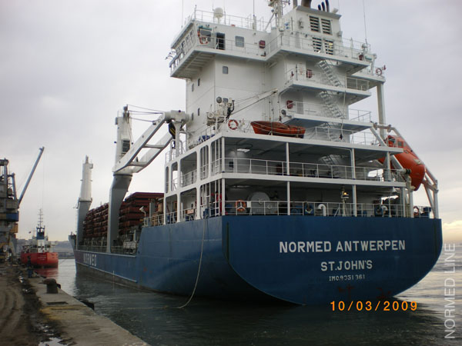
Turkey in Flanders
Normed
Shipping company with
strong presence
in Antwerp
Notes:
One of them is the shipping company Normed, that picked Antwerp as its main operational base in Western Europe.
My colleagues from the Netherlands are jealous about this. They have even approached the company and tried hard to convince Normed to move these operations to Rotterdam. But Normed knew better. They stayed in Antwerp, in Flanders.

Slide 19
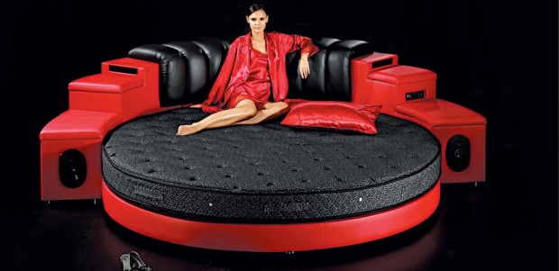
Turkey in Flanders
BRN
Mattresses, beds,
furniture.
Setting up
distribution
for Western Europe
in Antwerp.
Notes:
BRN, a furniture manufacturer, from Kayseri, set up a distribution center for Western Europe near Antwerp.

Slide 20

Turkey in Flanders
Kavaklidere
wines
Distribution center
for Western Europe
in Flanders.
Notes:
Kavaklidere, Turkish wine producer, has its European Distribution Center in Flanders.

Slide 21
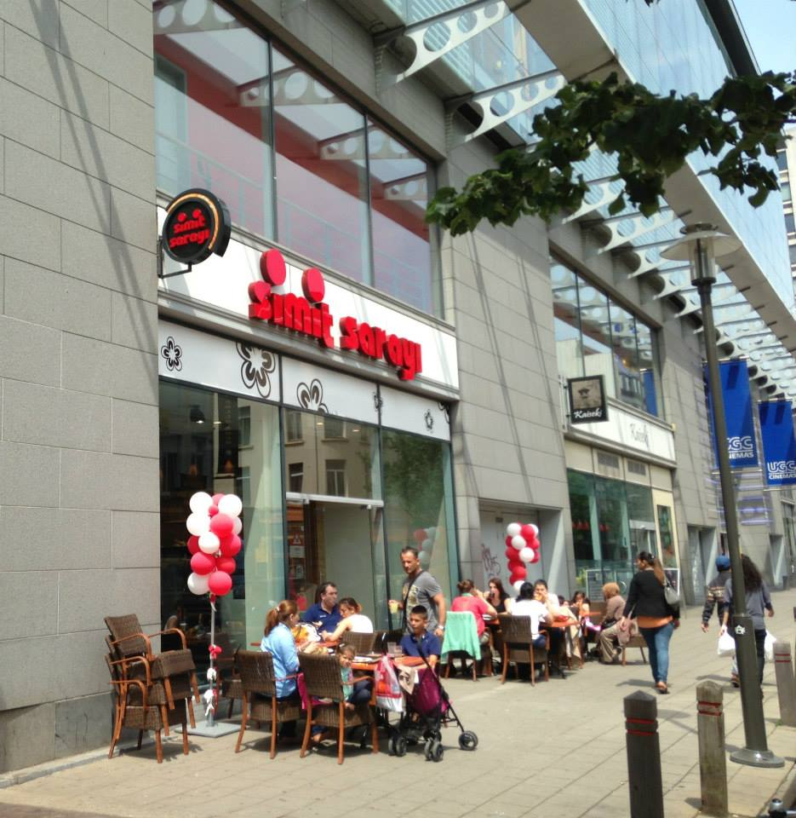
Turkey in Flanders
Simit Sarayı
Opening stores in Belgium,
since 2013.
Notes:
Simit Saray is there as well. So if you go to Flanders and you long for a taste of Turkey, you can find it.

Slide 22
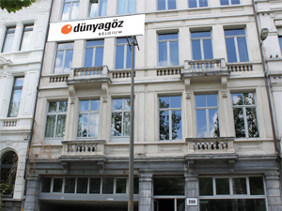
Turkey in Flanders
Dünyagöz
Eye clinic
in Antwerp.
Notes:
And if you have a problem with your eyes, you can find Dünyagöz over there as well.
So the only question that remains, is….

Slide 23
Turkey in Flanders
And you ?
Notes:
When will you go there?

Slide 24
Why would you invest in Flanders?
Flanders…
Your best link to the European market
Notes:
Why would a Turkish company go to Europe, invest in Europe? After all, Europe’s economy has not been doing so well in the last few years, other countries have been growing faster, other markets have opened.
All of this is true. There’s no denying that.
But some of these faster growing countries, are now cooling down. Think of China, e.g., where the growth rate is coming down.
And some of the markets that had opened, have in the meantime become much more difficult, like Iraq or Syria.

Slide 25
Why would you invest in Europe?
Follow your export potential :
EU is still the largest export partner of Turkey,
and it’s share is rising again.
EU-28's share in Turkey's exports increased to 44%
from 41.4% (Aug. 2013) to 44.3% (Aug. 2014)
from 42.9% (Sept. 2013) to 43.9% (Sept. 2014)
Notes:
So a first answer to the question is very simple : follow your exports.
The EU is still the largest export partner of Turkey,
and since last year already it’s share is rising again.
The share of the EU”s 28 countries in Turkey's exports increased to around 44%.
Still, now and then, here in Turkey and elsewhere, I hear people talking about Europe being in decline, losing its importance, ready for the proverbial ash heap.
To that I would like to answer with a quote about Europe, a quote that I took from a recent article in Foreign Policy magazine.

Slide 26
Why would you invest in Europe?
Foreign Policy magazine :
.… “the declinists would do well to remember a few stubborn facts.
Not only does the European Union remain the largest single economy in the world,
but it also has the world's second-highest defense budget after the United States, with more than 66,000 troops deployed around the world
The EU's GDP per capita in purchasing-power terms is still nearly four times that of China, three times Brazil's, and nearly nine times India's.
If this is decline, it sure beats living in a rising power.”
Notes:
It goes like this :
.… “those who talk about Europe’s decline, would do well to remember a few stubborn facts.
Not only does the European Union remain the largest single economy in the world,
but it also has the world's second-highest defense budget after the United States, with more than 66,000 troops deployed around the world
And : The EU's GDP per capita in purchasing-power terms is still nearly four times that of China, three times Brazil's, and nearly nine times India's.
If this is decline, it sure beats living in a rising power.”
(It is not me saying this, it is not some European public relations organisation, no, it is the American magazine Foreign Policy.)

Slide 27
The heart of the European market
I.
Notes:
First of all, Flanders really lies in the heart of the European market.

Slide 28
Flanders at the heart of Europe
750 km
Flanders offers logistics operations access to the largest one-day-market in Europe: main markets can be served within 24 hours
500 km
250 km
53.8 Mio consumers
130.5 Mio consumers
227.3 Mio consumers
Total EU population:
507,4 Mio
Total EU GDP:
USD 16.900 bn
Notes:
Our country, our region, is really at the center of the most wealthy part of Europe.
Total EU gross domestic product is more than 14 trillion EUR, or 16,9 trillion USD.
60% of the European purchasing power lies within a radius of 500 km around Flanders.
But being at the center is not enought. After all, you can go a little to the south, or to the east, or to the north, and still claim you’re at the heart.
040108

Slide 29
Excellent infrastructure for logistics
2.
Notes:
So we are at the right location, in the center of a wealthy part of the world, as you saw.
But the question remains : do we have what it takes, in terms of infrastructure, to reach out to your potential customers in these markets of Europe? Do we have them?

Slide 30
Excellent Infrastructure
Airport of Brussels (in Zaventem, Flanders)
Dense roadway network (all toll free)
Dense railroad network - with regular freight trains from and to Turkey
Dense inland waterway network connected to Europe’s most important markets.
3 international seaports : Antwerp, Ghent, Zeebrugge
Notes:
Yes, we do. We do have the air and road and railroad and waterway connections.

Slide 31
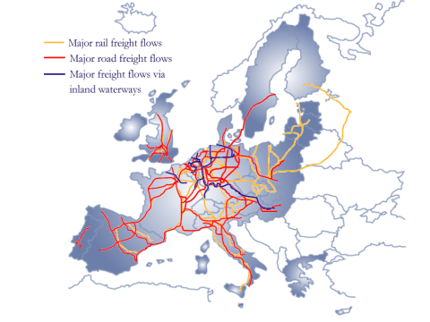
Flanders - Attractive for logistics & distribution
Deliveries within
24u -48u
Notes:
And yes we have the necessary expertise and knowhow of our logistics companies to guarantee smooth distribution. In 24 hours to most of the EU. In 48 hours to the most remote parts of EU, if needed.

Slide 32




The Port of Antwerp
Largest break-bulk port in Europe
      N° 1 in Steel
      N° 1 in Fruit
      N°1 in Forest Products
  European hub for steel, project cargo…
  Fully automated fruit storage
  4th largest petrochemical cluster in the world

Slide 33

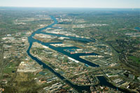
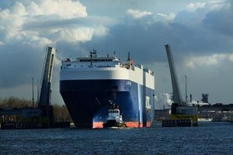
The Port of Ghent
Largest fruit juice import in the world
        Brazil is the FIRST trade partner for port of Ghent (20% of maritime traffic)
  Largest agri-bulk storage port in Europe
  Largest bio fuels R&D and production cluster in Europe
  Largest integrated steel mill in the world (Arcelor Mittal)
  Largest newsprint paper mill in the world (Stora Enso)
  ‘Brazilian’ dry bulk port (ores, cereals, soybeans, salt)

Slide 34

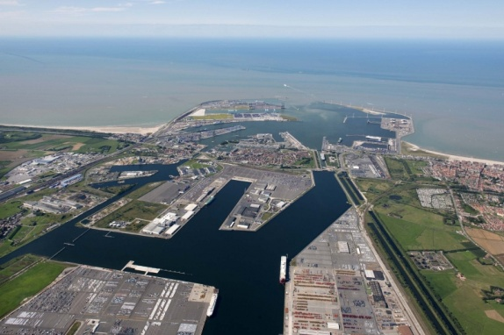
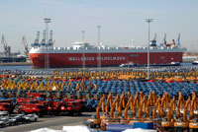
The Port of Zeebrugge
Largest hub port for new cars (a.o. from Turkey)
Largest forest products terminal
European production centre for TROPICANA products (part of European FOOD centre)
LNG terminal looks after 15% of the European gas distribution

Slide 35
Antwerp is Nr. 1 port in Europe for Turkey
In 2012 :
> % 50 market share
Source: Eurostat
Notes:
One more important slide, I think : in total maritime trade between Europe and Turkey, Antwerp has a market share of more than 50%!
It is by far the number one; much more important than Rotterdam, or hamburg, or Le havre, etc…

Slide 36
Distances from ports to the European hinterland
to | ANTWERP | HAMBURG | LE HAVRE | ROTTERDAM
Duisburg | 179 | 378 | 615 | 223
Cologne | 222 | 413 | 576 | 282
Ludwigshafen | 424 | 570 | 729 | 502
Frankfurt | 413 | 489 | 771 | 475
Munich | 780 | 769 | 1008 | 842
Valenciennes | 168 | 687 | 297 | 274
Lille | 132 | 670 | 286 | 248
Paris | 362 | 902 | 196 | 455
Strasbourg | 491 | 701 | 683 | 593
Lyon | 785 | 1125 | 656 | 887
Venlo | 151 | 409 | 544 | 191
Geleen | 128 | 468 | 501 | 212
Amsterdam | 160 | 468 | 604 | 77
Bâle | 623 | 811 | 693 | 725
Milan | 956 | 1102 | 1038 | 1059
Vienne-Innsbruck | 873 | 932 | 1100 | 935
D
F
NL
CH
IT
A
Notes:
One more thing you need to know : the distances from Antwerp to most of the main commercial & industrial centres in Europe are shorter than from other competing ports like Rotterdam in the Netherlands, or Hamburg in Germany.
So even if your main market or target in Europe would be Germany, it may be a very good idea to set up your distribution center in Flanders, because it is much closer to the heartland of Germany, than Hamburg, far away up north.

Slide 37
Cargo traffic between Antwerp and Turkey around 10 million tonnes (maritime traffic)
Main cargo flows:
Antwerp to Turkey :
    Containers
    Scrap
    Metal products
    Chemical products
Turkey to Antwerp :
    Containers
    Metal products
    Non-ferro ores
Turkish clients ::
  Vestel
  Arçelik
  Petkim
  Erdemir
  Borusan
  Ford Otosan
  Oyak Renault
:
  Ülker
  Tiryaki Agro
  Cayeli Bakir Isletmeleri
  Ekin Maden
  Gübre Fabrikalari
  Eti Mine Works
  Etc.

Slide 38
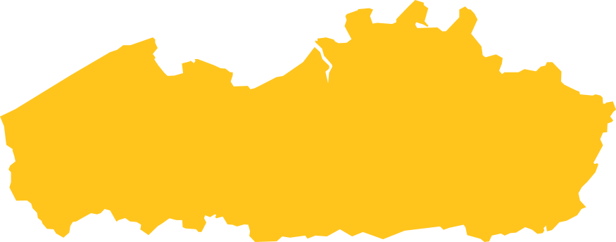
European Distribution Centers
Nike
Procter & Gamble
Samsonite
Black & Decker
Duracell
SKF
Sara Lee
Bose
Toyota
Honda
Mazda
Becton Dickinson
Volvo
Scania
Pfizer
Pioneer
+50 EDCs/1,000 km²
The highest concentration in Europe!
With the highest concentration of pan-European distribution centers Flanders has a proven track record
Notes:
With all of that, it will not come as a surprise that numerous multinational companies have chosen Flanders as location for their European Distribution Center, or EDC.
The names are there : Nike, Procter & Gamble, Toyota, Pfizer, and so on…
So we can honestly say that Flanders has a proven track record.

Slide 39
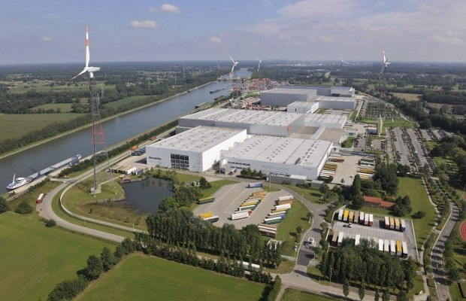
Nike European Logistics Center (ELC)
Notes:
To highlight just one example, I take the European Logistics Center of Nike, for their sports shoes and apparel.
It is their logistics hub for Europe Middle East and Africa.
And it keeps growing. They already have two sites, good for 250.000 m² of surface, with around 2000 employees and exports to 50 countries. And they are building a third site now, that will have an extra 500 employees.

Slide 40
Main factors that drove Nike’s investment decision :
Excellent connections to all clients in the EMEA region
Flanders is right at the centre of European spending power
Flexible employment framework offered by the Government of Flanders : it allows Nike to handle actively peaks (and low periods) without difficulty
Favourable employment situation in the region : access to a large pool of motivated workers with different educational backgrounds
Optimal use of inland multimodal platforms
“ Flanders is the best location in Europe”
K. Van Doninck, General Manager, Nike ELC Laakdal
Notes:
What are the main factors that drove Nike’s decision?
You can read with me :
Excellent connections to all clients in the EMEA region
Flanders is right at the centre of European spending power
Flexible employment
Etcetera
All of which lead the general manager to the conclusion that Flanders is the best location in Europe.

Slide 41
Advantageous taxation
& generous incentives
3.
Notes:
Now we come to another important factor : taxation.
I will not go into too much detail, if you want we can give more information afterwards.

Slide 42
Generous incentives
Competitive package
    Cash grants, employment and training-related incentives
    Tax deductions, leasing schemes…
    Accelerated depreciation…
Special tax systems : fiscal rulings, notional interest deduction, patent income deduction, investment deduction on R&D investments...
A unique non-resident expatriate taxation system
Notes:
I just want to bring to your attention that Belgium is a worthy alternative to the Netherlands, in terms of taxation.
I have learned over the past few years here that the advantages of the taxation system of the Netherlands are well known in Turkey.
One of the key messages of today’s meeting is that our Belgian corporate taxation deserves to be better known in Turkey as well, because it is very competitive.
The details will be brought to you later in this session by Mr. Wolfs, from the Belgian Ministry of Finance.

Slide 43
Nominal Corporate Tax Rate (NCTR)
Sources : ZEW, Centre for European Economic Research, Manheim
Effect iveTax Levels – Final Report 2012
Notes:
At first glance, Belgian corporate tax rate seems rather high, compared to other countries in the neighbourhood, but if you take into account the different deductions etcetera, it turns out Belgium’s corporate tax is VERY competitive.

Slide 44
Effective Corporate Tax Rate (ECTR)
Sources : ZEW, Centre for European Economic Research, Manheim
Effect iveTax Levels – Final Report 2012
Notes:
but if you take into account the different deductions etcetera, it turns out Belgium’s corporate tax is VERY competitive.

Slide 45
A Hidden Gem : Notional Interest Deduction
What is it?
« Kuramsal faiz indirimi »
A ‘notional’ (fictitious) interest calculated and applied to the equity of the company, and then deducted yearly from the taxable basis
used to off-set operational or financial income (thus lowering effective tax rate)

Slide 46
Hidden Gem : Notional Interest Deduction
P&L Account | Before N.I.D. | After N.I.D
Profit before tax | 4000 | 4000
N.I.D. (2,742%) | / | 2742
Taxable | 4000 | 1258
Corporate Tax (33,99 %) | 1360 | 428
Effective Tax Rate | 33,99 % | 10,6 %
Notes:
One unique measure we have e.g. is the “Notional Interest Deduction”, that ALL companies can apply.
Here is one example, of one company, where this Notional Interest Deduction helped the company to lower its effective corporate tax rate to 10,6%.

Slide 47
Talent, skills, knowhow
4.
Notes:
Another important reason to invest in Flanders, is the talent, the skills, the knowhow that you will find available there.
Again, examples speak louder than long theoretical explanations. So let me just give you some examples.

Slide 48
Highly skilled workforce
Multilingual, highly educated and loyal & productive labour force
Excellent education quality: compulsory education up to the age of 18
Flexibility :
    Work on weekends is allowed
    Some sectors : 10h shifts !
120.000 Turkish speaking people
Notes:
So yes, we have a highly skilled workforce, that is multilingual as well, and productive
We have an excellent education quality, with compulsory education up to the age of 18.
Our regulations allow for flexibility in the workplace
And, also important : there are around 120.000 Turkish speaking people in Flanders, including lawyers, accountants, consultants, enginneers, all kinds of experts that you may need

Slide 49
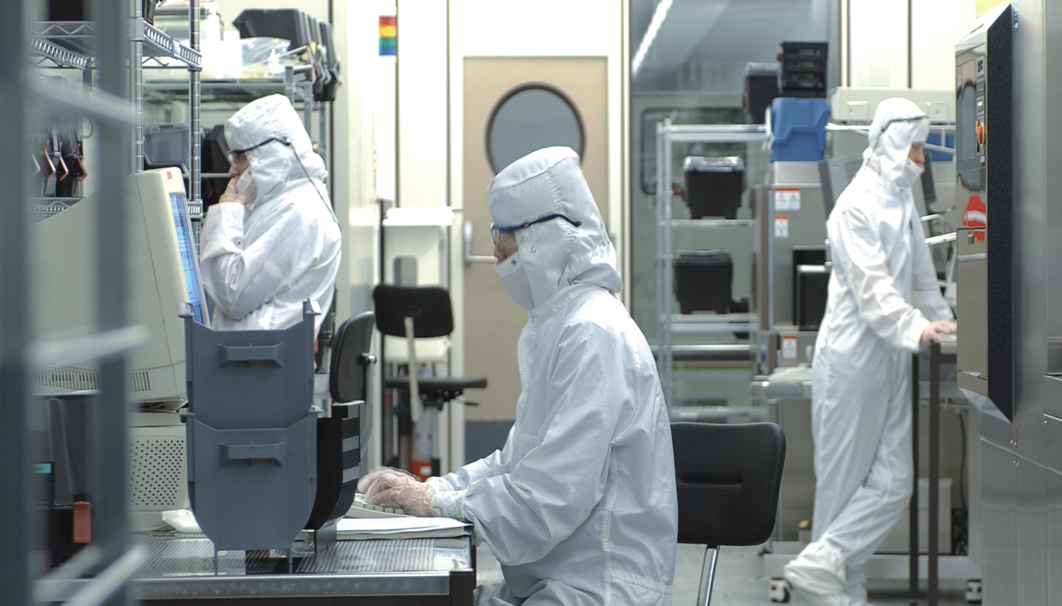
Flanders’ IMEC, technology partner of Samsung
Knowhow
IMEC (Leuven).
World class
nanotechnology
research institute.
Main partner of Samsung
in its e-health program.
Notes:
And we have world famous research institutions.
IMEC for instance, is one that we are very prouod of : a nanotechnology research institute that counts more than 2000 researchers, and that is recognised worldwide.
That was proven once more very recently, when Samsung announced it is entering the big new domain of e-health, and it chose IMEC as main technology partner for that.

Slide 50




Four Strategic Research Centres of the Flemish government
Notes:
And we have other similar strategic research institutions in other fields as well:
iMinds, that does advanced research of innovative ICT services and applications
VIB, a biotech and Life Sciences Research Institute
And VITO, that focusses on technological innovations, mainly in Energy technology, Environmental modelling, etcetera...

Slide 51
What the surveys say
5.
Notes:
It is easy to claim of yourself that you are among the best, that your quality is superior, that your logistics are excellent.
Anyone can say these things. Any country or any region can claim to among be the best.
The harder part is to get these claims confirmed by independent, external assessments. Well, that is exactly what i’m going to show you now.

Slide 52
Outstanding results in international surveys
6.1. Quality Competitiveness
The assessment by “FDI Intelligence” is based on the weight model for the Regional headquarters profile which assesses each location across the following location factors:
    General Business Environment
    Labour Availability & Quality
    Presence of an industrial cluster
    Infrastructure and Accessibility
    Living environment
The average score for the selected locations is 100
Notes:
I do that with an assessment by FDI Intelligence, the publication of Financial Times Group, that focusses on Foreign Direct Investment.
It analysed 14 different regions in Europe in terms of their attractiveness to set up a regional headquarter, taking into consideration :
The General Business Environment
Labour Availability & Quality
Presence of an industrial cluster
Infrastructure and Accessibility
Living environment

Slide 53
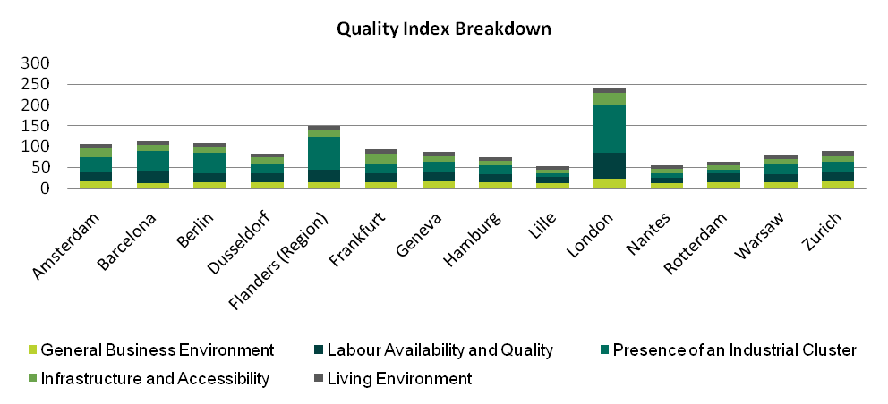
Locations with the highest quality scores:
London, Flanders (Region) and Barcelona
(Source: fDi Intelligence, from the Financial Times Ltd)
Notes:
Looking at those 5 parameters, Flanders comes out second, after London, and before Barcelona, Berlin, Amsterdam, Frankfurt, Düsseldorf, Rotterdam etcetera.
This is the score purely based on ‘Quality’. But as you all know, next to quality, there’s another important element, and that is : the price to pay, the operating costs.

Slide 54
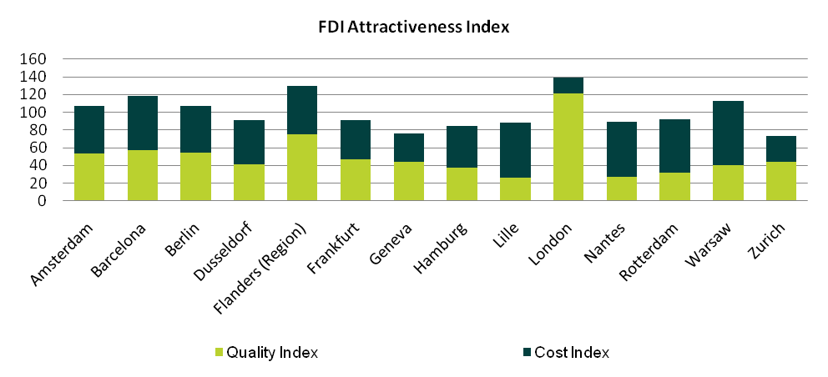
Outstanding results in international surveys (2)
1. Location Attractiveness
The location attractiveness index shows the overall attractiveness of the 14 selected locations for the Regional headquarters profile. The ratio of quality to cost is 50:50
(Source: fDi Intelligence, from the Financial Times Ltd)
Notes:
If you include that cost aspect as well to calculate the location attractiveness, and you give 50 points on Quality, and 50 points on Costs, then Flanders still ranks number two, and the difference with London has almost disappeared

Slide 55
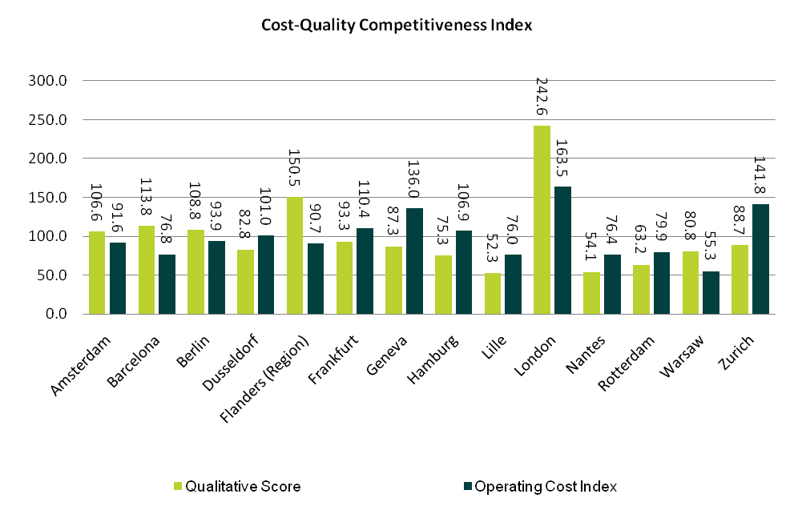
Outstanding results in international surveys (3)
2. Cost quality competitiveness
(Source: fDi Intelligence, from the Financial Times Ltd)
Notes:
Then there is a third way of looking at things. That is to look at the ratio of Quality to Costs.
Simply said, this is : how much quality do you get for the price you pay?
Looked at it this way, Flanders is number one. Meaning : in Flanders you get the best «value for money ».

Slide 56
Locations with the highest quality for a given level of cost are…
The cost quality competitiveness graph shows the value for money of each location option. The graph indicates that:
  The top locations offering the highest quality for a given level of cost are Flanders (Region), London and Barcelona
  Flanders (Region), London and Barcelona offer an above average level of quality and good value for money as their relative quality is higher than their relative cost

Slide 57
A Unique Opportunity
Flanders…
Your best link to the European market
Notes:
With all the arguments that I’ve been giving, I assume that by now you are all convinced to say « YES! I WANT TO INVEST IN FLANDERS ! «
Well, in that case, here is a unique opportunity for you.
No joke. I’m serious here. I will round off my presentation here with just one more slide of a specific investment opportunity that there is currently in the Port of Antwerp.
It’s a huge project, so it is only for investors with very deep pockets. But I believe it may be interesting for some of you.

Slide 58
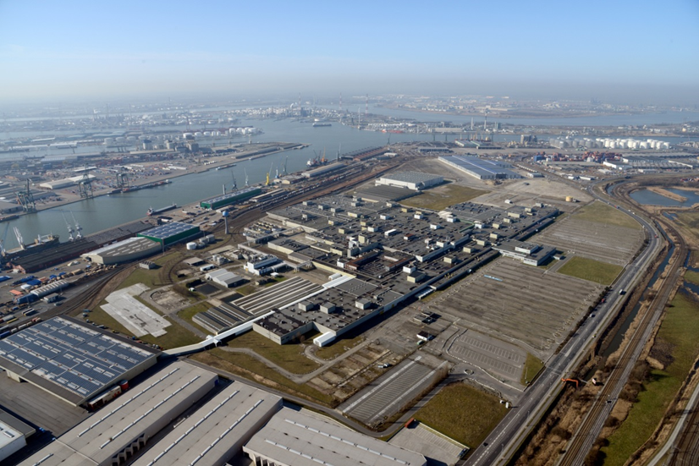
‘Churchill industrial zone ‘ in the port of Antwerp
96-hectare
for industrial activities
trimodal access
market tender
applications till 15/01/2015
to Port of Antwerp Authority
10-98 - 080133
Notes:
This is what I talk about: the Churchill site, in the port of Antwerp.
It’s a 96-hectare site for industrial activities, with excellent accessibility by rail, by road and by water.
On a dream location. And it is currently up for sale, in a market tender process, for which interested parties may submit their applications until the 15th of January, to the Antwerp Port Authority.

Slide 59
www.investinflanders.com
Thank you for your attention

Slide 60
Contact
Flanders Investment & Trade
Mr. Raphael Pauwels
c/o Consulate – General of Belgium
Siraselviler Caddesi No: 39
34433 Taksim – Istanbul
T. +90 (0)212 293 99 17
F. +90 (0)212 293 99 27
istanbul@fitagency.com
www.flandersinvestmentandtrade.com

