Slide 1
An Overview of
Economic Incentives
in the United States
Kocaeli
9 February, 2015
John Woodward
Senior Director, Foreign Investment
Metro Atlanta Chamber
Atlanta, GA, USA

Slide 2
Federal / State / Local
Statutory / Discretionary
Industry specific
Geographic specific
Macro

Slide 3
State
Often Tax Credits
Jobs-based
Infrastructure (local collaboration)
Workforce Training, e.g., Georgia “Quick Start”
Targeted Industries, e.g., Georgia – Film production,
also included, digital media, interactive entertainment, etc
State assets – e.g., Georgia ports
R&D

Slide 4
Local
Real estate tax abatements
Personal property / machinery & equipment
Sales tax, e.g., construction, machinery
Grants, Loans
Industrial Development Authority
Industrial Revenue Bonds
Public Utilities
Permitting (Money & Time)

Slide 5
Macro
Incentives – initial, up front, maybe 3, 5, 10 years if lucky
Best economic incentive is selection of appropriate location

Slide 6
Chosen and managed correctly, these are incentives:
 Expenses - Operating & Capital
Labor Costs
Real Estate
 Taxes
Regulations
 Workforce
Skilled, educated
“Right-to-Work”
 Access to Market
Customers
Suppliers
 Universities
 Quality of Life
And other “Intangibles” …

Slide 7
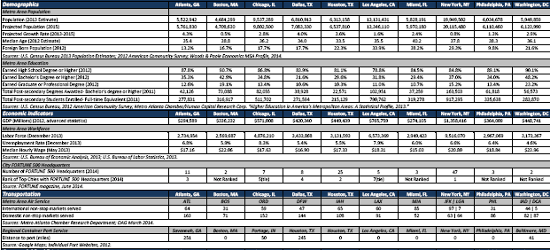
Demographics, Economic Indicators, Transportation

Slide 8
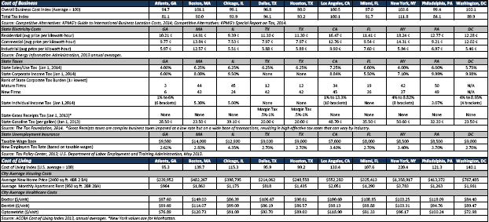
Cost of Business, Cost of Living

Slide 9
Cost of Living Index
U.S. Average: 100
Source: C2ER/ACCRA Cost of Living Index, 2013

Slide 10
Global & domestic access
Strategic Location
Most of the U.S. population lives in the eastern third of the country
More than 80% of U.S. consumers can be reached from Atlanta in two flight hours or two truckload delivery days
Atlanta

Slide 11
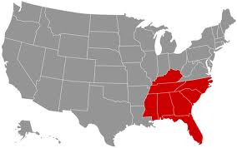
Georgia ranked as Top U.S. State for Business
… all in 2014
Atlanta

Slide 12
FORTUNE 500
FORTUNE 1000
Sources: FORTUNE magazine, June 2, 2014

Slide 13
turkish presence in atlanta
Turkish Society of Georgia Tech

Slide 14
“Incentives cannot make a bad site good.”
Joseph Folz
General Counsel
Porsche Cars North America

Slide 15
“In fact, incentives, when you look at the whole picture, it's just a small piece. We're making a 50-year decision, and a pile of incentives in Year One, Two or Three over a 50-year decision doesn't make a gigantic impact.”
Steve Cannon
CEO
Mercedes-Benz USA

Slide 16
Guidance/Assistance with:
› Business Incentives & Taxes
› Land Site & Building/Space Search
› Customized Market Research
› Talent Availability, Quality & Cost
› Access to Business & Academic Leadership
› Facilitation with Regulatory Authorities
› Relocation Assistance
› Global Business Expansion
Gratis and Confidential

Slide 17
John Woodward
Senior Director, Foreign Investment
Metro Atlanta Chamber
235 Andrew Young International Blvd, NW
Atlanta, GA 30303 USA
+1.404.586.8447
jwoodward@macoc.com

