Slide 1
HYDROPOWER as an important strategic direction in the development of energy sector of the Kyrgyz Republic
2020

Slide 2
GEOGRAPHIC ASPECTS
Kyrgyz Republic
The country is 85th in the world by area (199 951 km²), 7th among the CIS countries.
Kyrgyzstan borders with China in the east and southeast, with Kazakhstan in the north, with Uzbekistan in the west and with Tajikistan in the south.
The mountainous systems of the Tien-Shan and Pamir dominate in the terrain, which occupies about 65% of the country.
The Republic is located 394 meters above the sea level, the average height above the sea level is 2,750 meters. Half of the territory is located at altitudes from 1000 to 3000 m above the sea level, and about the third part – from 3000 m to 4000 m.
Almost 90% of the country is located at more than 1,500 meters above the sea level.

Slide 3
Structure of policy and management in the power industry of Kyrgyzstan Republic
INFORMATION
State Property Management Fund under the Government
of the KR
State Inspectorate for Environmental and Technical Safety under the Government
of the KR
State Committee for Industry, Energy and Subsoil Use in KR
Government al Agency on F&E complex regulation under the Government of the KR
Generation of power and heat energy
“Electric Power Plants”
Installed capacity
3 892 MW
Kyrgyz State Scientific Research and Project Institute
Companies with private
property
Transmitting company
NEG of Kyrgyzstan
00/220/110/35 kW sub-station
Kyrgyz Komur SE
Distribution Companies
CPP
Small HPPs
Energy companies
Kurgyzteploenergo SE
Severelectro OJSC
National Energy Holding OJSC
OJSC
shares management
Scientific-Research Institute of Energy and Economics
Oshelectro OJSC
Jalalabadelectro OJSC
Vostokelectro OJSC
KESC OJSC
Chakan HPP OJSC
Bishkekteploset OJSC
3

Slide 4
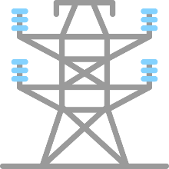
ENERGY GRID OF KYRGYZSTAN REPUBLIC
HPP
3070 MW
CHP
862 MW
HV line 110-500 kW
7 500 km
110-500 kW substations
194 items
HV line 0,4-35 kW – 58 000 km
Substations and HP – 22 798 items
Heat networks - 420 km
Due to geographical features, energy system of the Kyrgyz Republic is clearly divided into northern and southern parts. Both parts are connected by 500 kV “Toktogul HPP – Frunze” line passing through the territory of the Kyrgyz Republic, as well as through the Central Asian Consolidated Power System covering the Republic of Tajikistan, the Republic of Uzbekistan and the Republic of Kazakhstan, and 500 kV “Datka Kemin” line.
The major part in the structure of power generation is occupied by hydropower plants (90%), the biggest part of which are located in the south of the country..

Slide 5
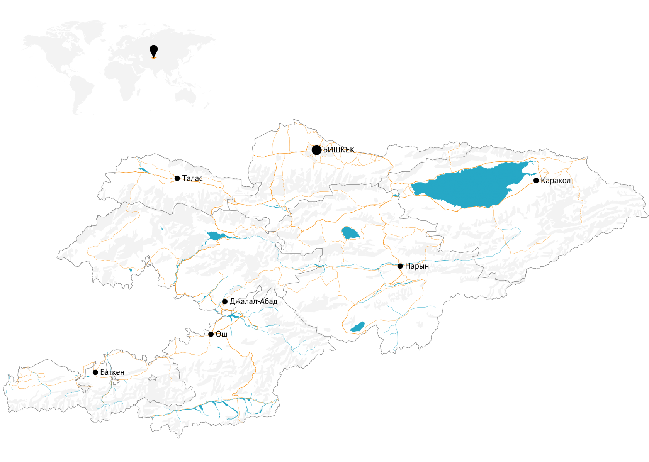
HYDROPOWER POTENTIAL
The total hydropower potential of the Kyrgyz Republic is about 142 bln kW/h
The Republic occupies the third position in the CIS after Russia and Tajikistan
Only 10% of hydropower potential is employed
8 cascades of 34 hydropower plants may be built on the largest Naryn river.
The total installed capacity of the promising cascades is 6 450 MW
The annual average annual output of more than 25 bln kW/h of electric power

Slide 6
THE MOST PROMISING PROJECTS
Name | Installed capacity, MW | Long-term average generation of electric energy (million kW/h) | Availability of feasibility study and project
Kambarata HPP-1 | 1860 | 5 640 | Feasibility study is developed
Upper-Naryn cascade of HPPs | 237,7 | 942,4 | Feasibility study and project are developed
Sary-Dzhaz cascade of HPPs | 1100 | 4 764 | Development is needed
Susamyr-Kokomeren cascade of HPPs | 1305 | 3 317 | Pre-feasibility study is developed
Kazarman cascade of HPPs | 1160 | 4 661,6 | Development is needed
Small HPPs | 95 | 450 | Pre-feasibility study is developed
Solar Power Plant in Chui region | 100 | 150 | Development is needed

Slide 7
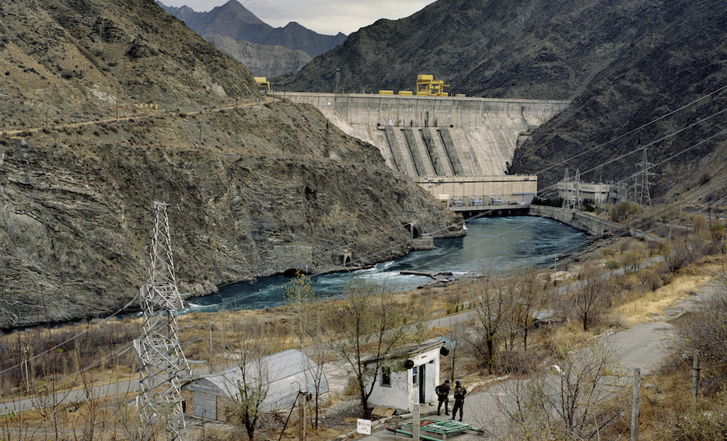
Kambarata HPP-1
Kambarata HPP-1 | Normal water level, NWL, m | Installed capacity, MW | Power generation, mln kW/h | Water storage capacity, mln m3 | HPP type
 | 1 198 | 1860 | 5 640 | 2 730 | located near a dam
Location:
The damsite of Kambarata HPP-1 is located on the Naryn river in the V-shaped canyon, 14 km above the Kambarata HPP-2.
Construction infrastructure:
There is a production infrastructure that was used in construction of Kambarata HPP-2.
There are sufficient reserves of construction materials quarries for construction of Kambarata HPP-1 dam.
Close proximity of the nationwide highway and 500 kV power line connecting the north and the south of the country
Feasibility study is developed
(SNC Lavalin International Inc.)
Notes:
7

Slide 8
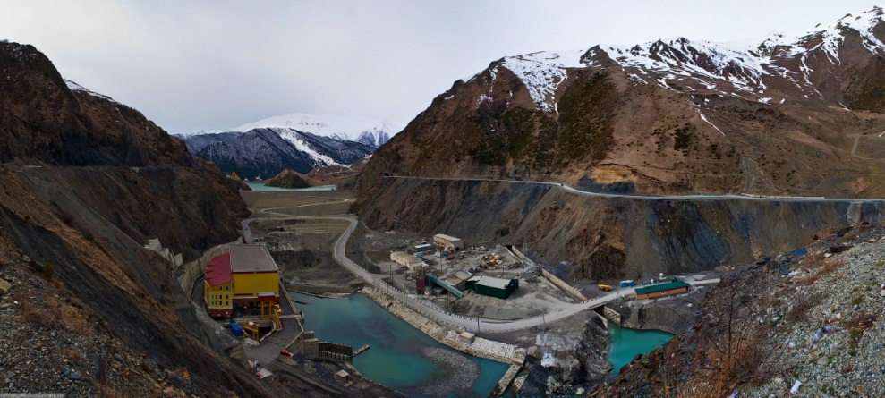
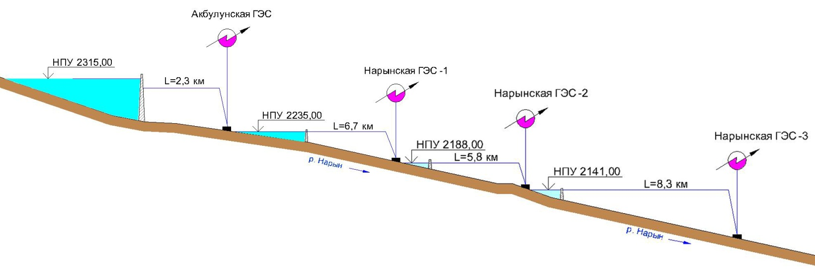
Upper-Naryn cascade of HPPs
HPP name | Installed capacity, MW | Long-term average annual generation of electric energy (mln kW/h) | Dam height, м | Construction timeframe, months
Akbulun HPP | 87,4 | 345,5 | 75 | 72
Naryn HPP-1 | 47,7 | 187,5 | 20,5 | 36
Naryn HPP-2 | 47,6 | 188,8 | 19 | 36
Naryn HPP-3 | 55,0 | 220,5 | 9 | 48
Total | 237,7 | 942,4 |  | 86
Location:
The cascade is designed in the upper reaches of the Naryn river with absolute elevations of 2100-2300 m. All plants are designed according to dam-derivation scheme with small reservoirs, which reduces the area of the flooded land.
Construction infrastructure:
The production infrastructure is available.
Close proximity of the nationwide highway
There is a 35 kV active overhead power line on the right bank of the river
The main mode of transport in the construction area is motor transport.
The nearest “Balykchy” railway station is located at a distance of 183 km
The land necessary for construction of hydro power plants is allocated
Feasibility study and a part of project documentation is developed
Notes:
8

Slide 9
Sary-Dhaz cascade of HPPs
Name | Water reservoir capacity, mln m3 | Installed capacity, MW | Generation, mln kW/h
Kuyluk | 650 | 170 | 450
Inylchek | 18 | 60 | 204
Kaindy-Inylchek | 40 | 20 | 80
Akshiyrak | 500 | 350 | 1230
Kokshaal | 20 | 250 | 1390
Kuyukap | 20 | 250 | 1410
Total: |  | 1100 | 4764
Location:
The Sary-Dzhaz River originates from the Semenov Glacier and flows to the east of the Issyk-Kul Lake in the direction from the north to the south. The climate in Sary-Dzhaz terrain is severe, sharply continental with cold winters and short summers. The average temperature of the coldest month of the year - January is 19-20ºC below zero, and of the warmest month - July is 10ºC above zero.
Geographicall location is Ak-Suu district of Issyk-Kul region.
Notes:
9

Slide 10
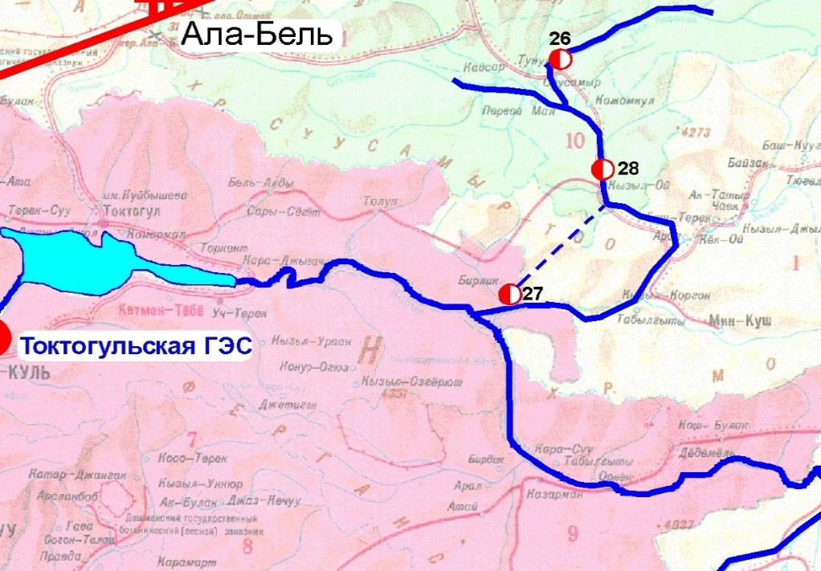
Susamyr-Kokomeren cascade of HPPs
Name | Water reservoir capacity, mln m3 | Installed capacity, MW | Generation, mln kW/h
Karakol | 400 | 33 | 95,0
Kokomeren 1 | 680 | 360 | 848
Kokomeren 2 | 19,5 | 912 | 2374
Total |  | 1305 | 3317
Location:
Susamyr-Kokomeren cascade of hydro power plants (hereinafter referred to as “SKC”) is located on the Kokomeren river, which is a tributary of the Naryn river. Water catchment area is 10400 sq.km, length - 199 km. The average height of the basin is 2737 m. The highest average monthly temperature in the area of Chaek village is 39ºC above zero, the lowest temperature is 37ºC below zero.
It is geographically located in Dzhaiyl district of Chui region and Toktogul district of Jalal-Abad region.
Notes:
10

Slide 11
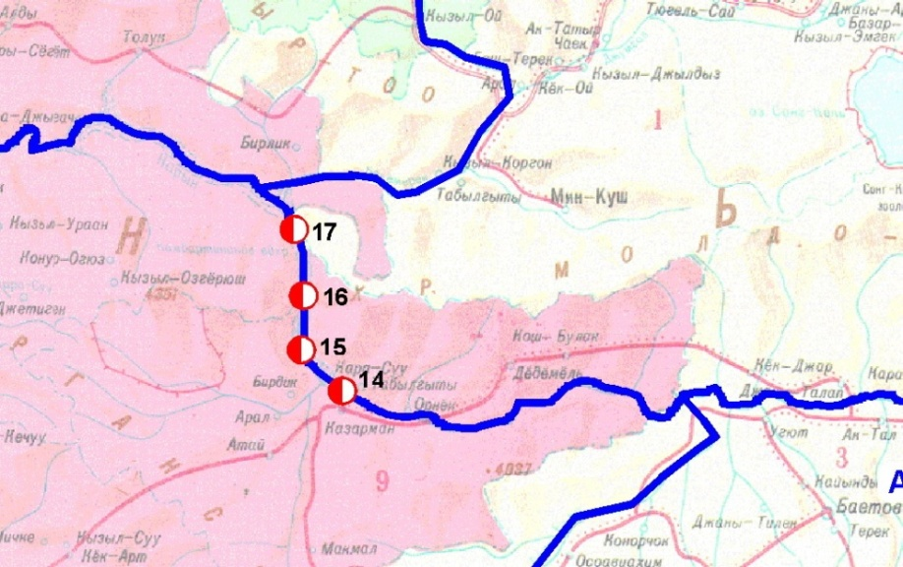
Kazarman cascade of HPPs
 | Normal water level, NWL, m | Installed capacity, MW | Power generation, mln kW/h | Water storage capacity, mln m3 | HPP type
Alabuga HPP | 1 570 | 600 | 2 358,3 | 2 835,5 | located near a dam
Karabulun HPP-1 | 1 370 | 149 | 536 | 110 | located near a dam
Karabulun HPP | 1 370 | 163 | 852 | 110 | derivational
Toguztorou HPP | 1 327 | 248 | 915,3 | 168,5 | located near a dam
Total for the cascade |  | 1 160 | 4 661,6
Location:
Kazarman cascade is located on the site of the Naryn river between the tributaries of the Alabuga and the Kokomeren rivers.
Construction infrastructure:
The existing nationwide highway with a length of 155 km provides the access from Naryn zone to the cities of Osh and Jalal-Abad.
In addition, the construction of an alternative North-South highway has begun in the area.
Precipitation - 303 mm per year; the relief is mountainous; seismic activity is 9 points.
Notes:
11

Slide 12
Kara-Keche ТPP
 | Installed capacity, MW | Power generation, mln kW/h | Fuel | Source of technical water supply | Water consumption | Stack height
Kara-KecheТPP | 600 MW (2х300 МW) | 3 900 | Brown coal (consumption 397.4 tons/h) | Dzhumgal river / Kokomeren river | Summer time 45 m3/s Winter time 42 m3/s | 330 m
Location:
Kara Keche deposit is located in Naryn region and belongs to Kavak coal basin:
- Iocated 220 km away from Balykchy railway station;
- estimated capacity - 4.1 million tons per year
Reserves of the basin amount to 1.85 billion tons.
Construction infrastructure:
The main mode of transport in the construction area is automobile. The distance to the nearest Balykchy railway station on a gravel-asphalt road is 230 km.
Precipitation - 440 mm per year; the relief is mountainous; seismic activity - 9 points.
Kara-Keche TPP
Notes:
12

Slide 13
THE ROLE OF RES IN THE COUNTRY’S POWER SECTOR
The issue of energy resources conservation is the most important priority for the Kyrgyz Republic. Also, we need to actively develop hydropower and other types of non-fuel energy as the most economical and environmentally friendly, and to expand the construction of energy facilities in the regions using the local resources, including, of course, the renewable and alternative energy sources

Slide 14
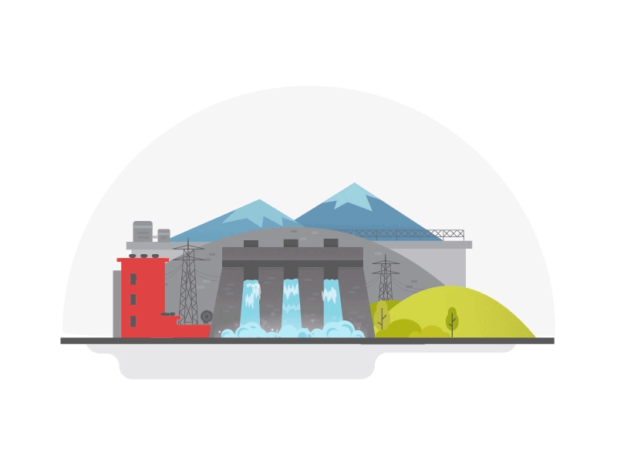
2100-2900 h.
Average annual duration of sun shining
258 MW
potential of small HPPs
44 mn kW/h
potential of wind energy
Annual emission on the surface
1700 kW/h per m2
1,5 bn kW/h

Slide 15
Stages of implementation of activities on generation and supply
of electrical energy using the renewable energy sources
INFOGRAPHICS
Inclusion of renewable energy entities in the Register of the renewable energy entities (Certificate, SCIESU KR)
Obtaining the rights for land plots (DPA, lG)
Obtaining the tariff preferences for the grace period within the established quotas (Decision, SCIESU)
Coordination of connection to electric networks.
Preparation of design and estimate documentation (RES entity - Grid Company)
Obtaining the selling license (License, SARFEC under the GKR)
Obtaining the tariff for the supply of electricity within the payback period (Order, SARFEC under the GKR)
Signing a contract for the supply of electric energy (CSE, RES entity - Grid Company - Buyer )
Construction of a plant using the RES (RES entity, contractors)
Acceptance and commissioning of a plant using the RES (State Commission)
15

Slide 16
2
1
Map of priority small HPPs
20 MW
25 MW
4
18 MW
3
25 MW
6
3 MW
No. | Name | Capacity, MW | Location, river
1 | Orto-Tokoi | 25 | Orto-Tokoi reservoir
2 | Kirov | 20 | Kirov reservoir
3 | Papan | 25 | Papan reservoir
4 | Karakul (Kara-Suu-1,2) | 18 | Kara-Suu river (left)
5 | Tayan | 3,5 | Sokh river
6 | Tortkul | 3 | Tortkul reservoir
3,5 MW
5

Slide 17
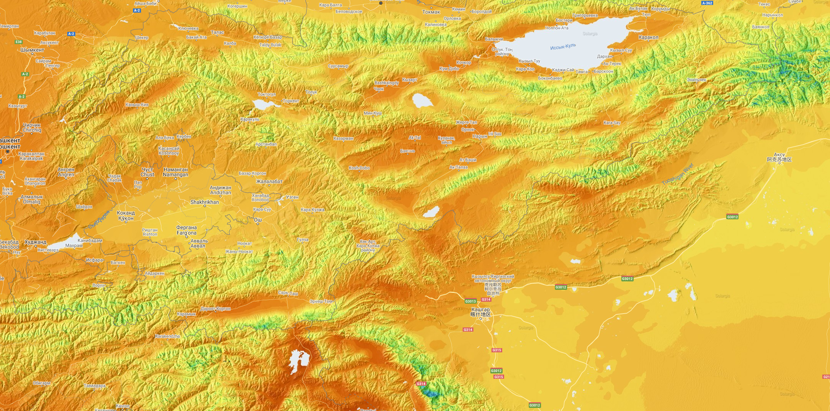
100 MW
Solar plant
Characteristics | Figures
Nameplate capacity | 100 MW
Power generation | 150 mn kW/h
Available space for construction of solar plants
Map of priority RES

Slide 18
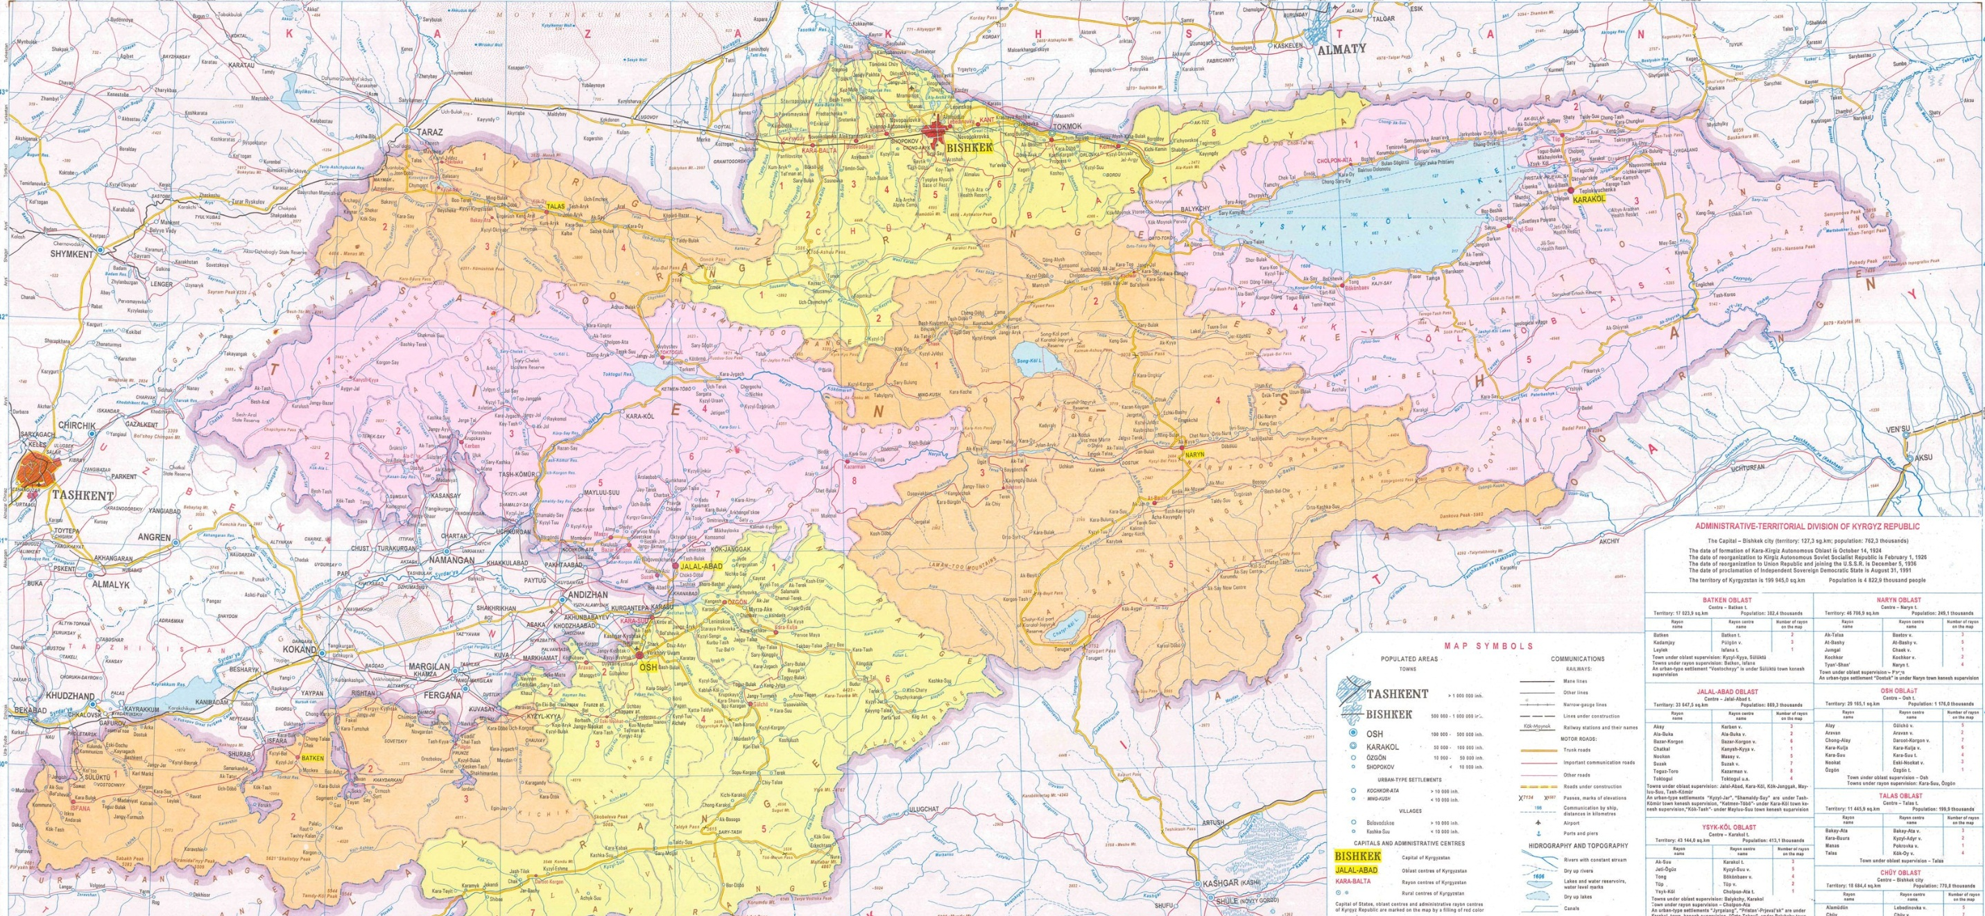
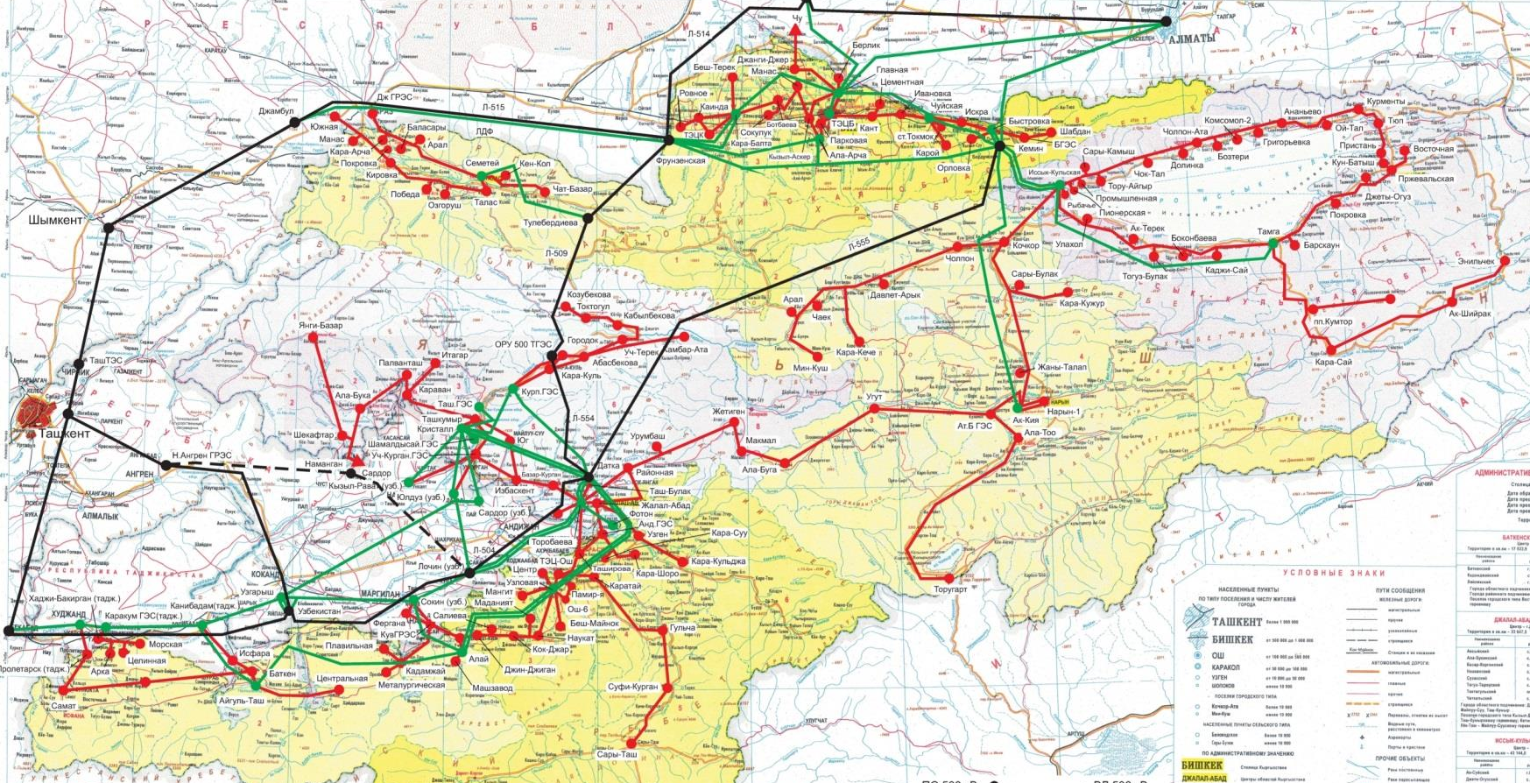
500 kW SS
220 kW SS
110 kW SS
500 kV HVtrL
220 kV HVtrL
110 kV HVtrL
HIGH VOLTAGE TRANSMISSION LINES (HVtrL)

Slide 19
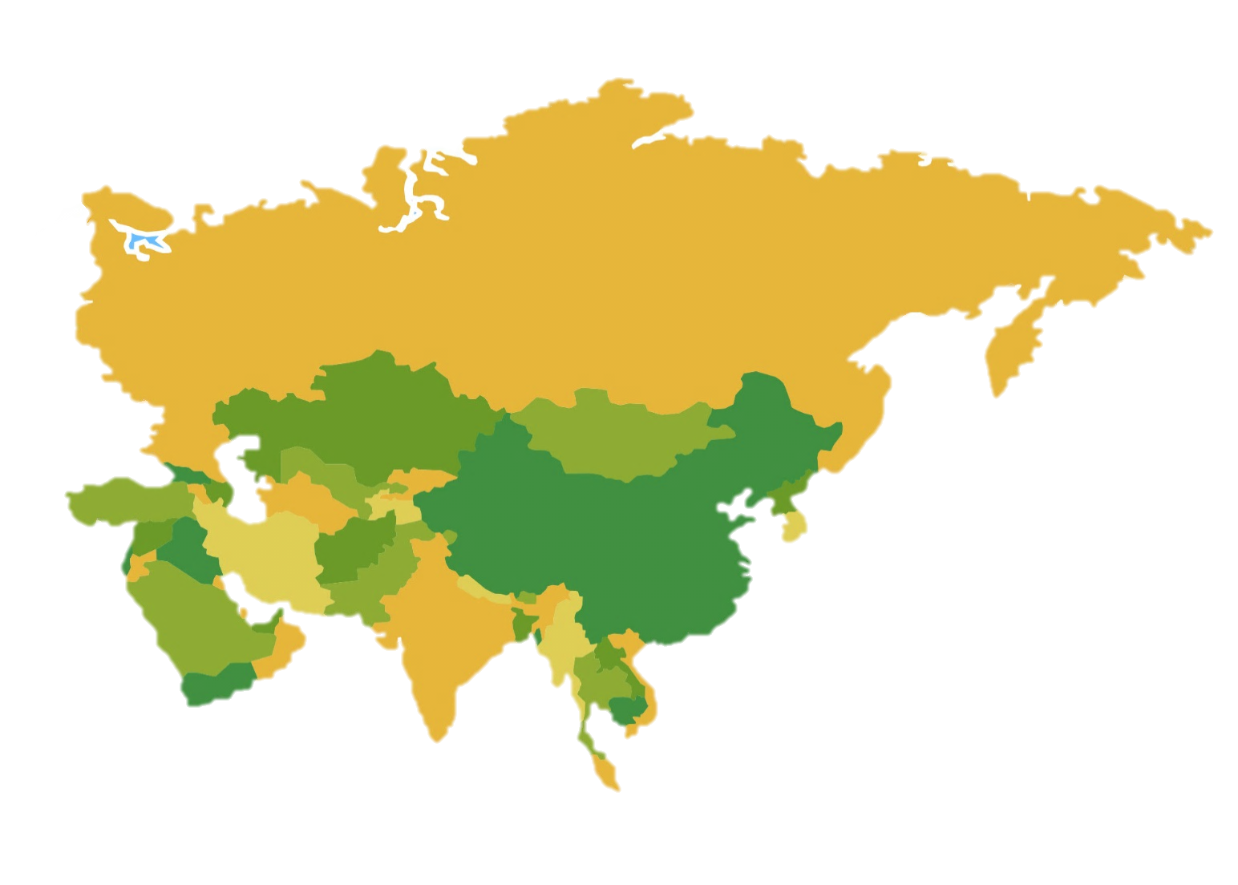
«СASA-1000» project implies the construction of a high voltage transmission line, connecting the energy systems of Kyrgyzstan and Tajikistan with Afghanistan and Pakistan for the export of electricity from Central Asian countries.
CASA-1000

Slide 20
THANK YOU FOR ATTENTION!!!

