Slide 1
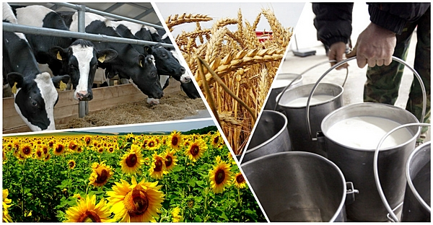
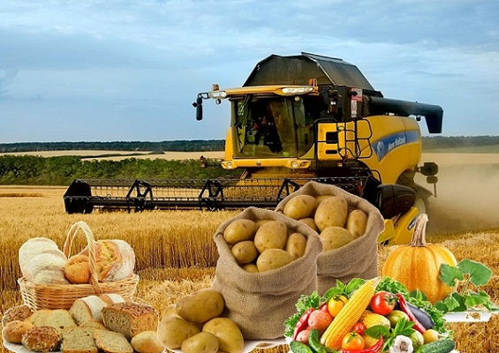
Ministry of Agriculture, Food Industry and Melioration
of the Kyrgyz Republic
Agricultural development in the Kyrgyz Republic
2020

Slide 2
Strategic location
Active member of the Integrational Unions (WTO, EAEU, CIS etc.).
On the way of “Silk Road”: access to EAEU, Europe, China, Middle East and South-East Asia.

Slide 3
Agriculture of Kyrgyzstan
12,6% (2019)
~ 2,6% (2017-2019)
Share of GDP
Development
~400 thous.
445
Farms
Cooperatives
10,4 mln ha
9,0 mln ha
Agricultural lands
Pasture
14%
65%
Active population
Rural population

Slide 4
Priorities
Organic production
Intensive gardening
Digitalization
Breeding
Logistic centers

Slide 6
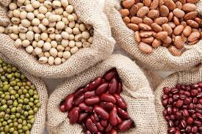
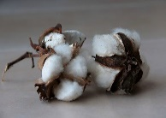
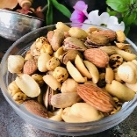
Export Capacity (thous. tons)
70,0-80,0
BEANS
125 – 135
FRUITS AND VEGETABLES
30-40
MILK AND DAIRY
PRODUCTS
20
MEAT AND MEAT PRODUCTS
23 – 25
1200
COTTON
POTATO
4
4
HONEY
NUTS

Slide 7
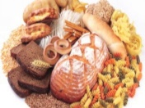
Food Industry (enterprises)
MEAT AND MEAT PRODUCTS
302
CANNED FRUITS AND VEGETABLE
314
fish products
26
500
MILK AND DAIRY
PRODUCTS
vegetable and animal oils
90
797
soft drinks
sugar and confectionery
154
7 204
flour and
flour products

Slide 8
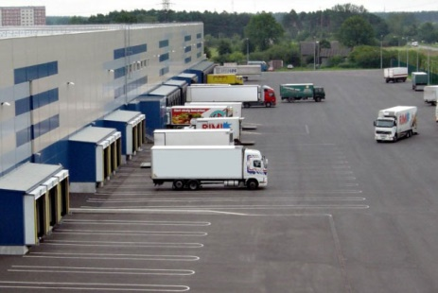
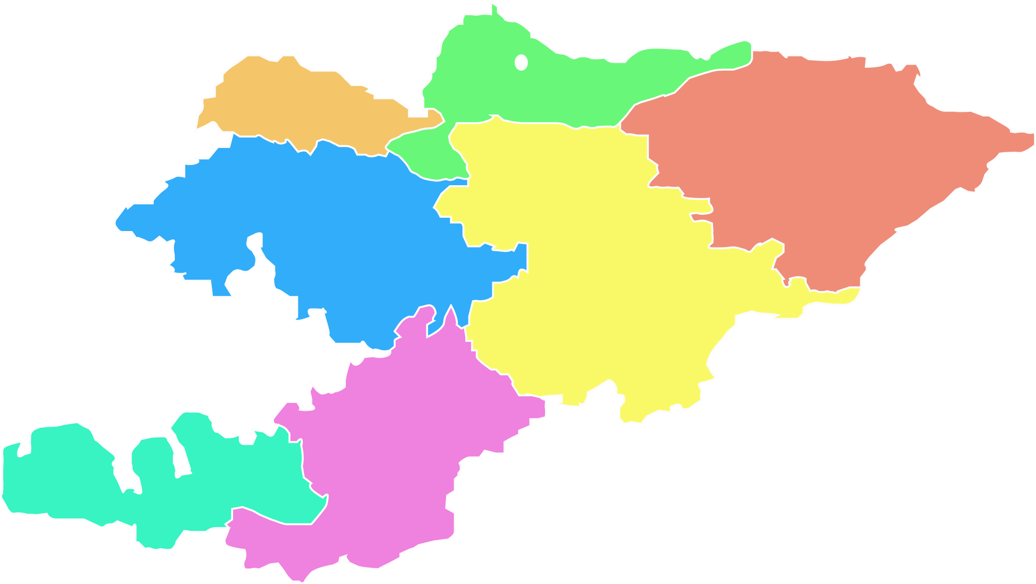
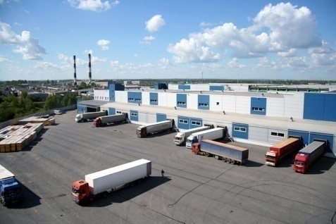
Logistic centers
«AgriproductsAsia»
«Kyrgyz Product Center»
«Kyrgyz farmer»
«Oberon»
«Seed potato»
«Rustambek»
«Aravan Agroservice»
«Abdulaev Shavkatbek»
«Turan–Of groups»
«Alimjanov Yakupjan»
Chui region
Talas region
Jalal-Abad region
Naryn region
Osh region
Batken region
Issyk-Kul region

Slide 9
Investment attractiveness
Liberal investment regime
Preferential treatment
Investment Law of the Kyrgyz Republic (March 27, 2003)
“0” taxes
Free use of income by investors
Forms of companies, branches, representative offices

Slide 10
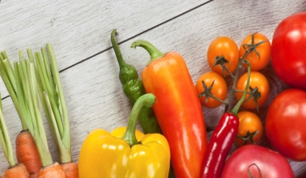
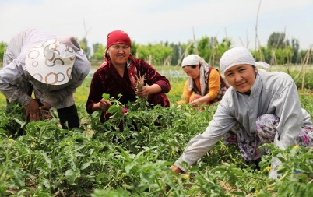
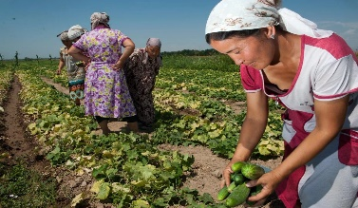
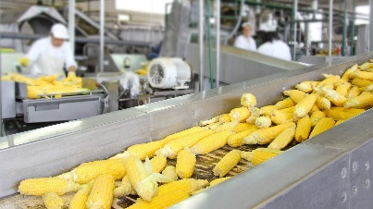
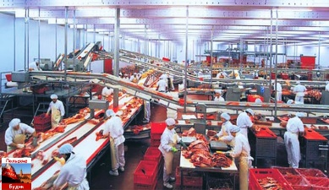
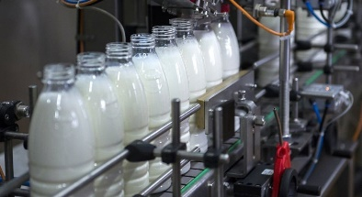
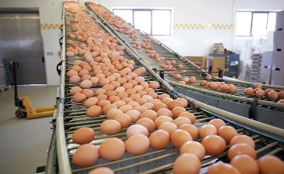
Thank you!

