Slide 1
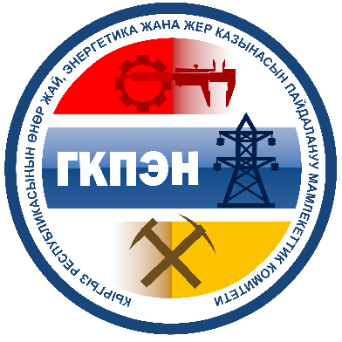
Prospects for the development of the mining industry of the Kyrgyz Republic
State Committee for Industry, Energy and Subsoil Use of the Kyrgyz Republic
www.gkpen.kg

Slide 2
Republic of Kyrgyzstan

Slide 3
Kyrgyz Republic Overview
Capital: Bishkek (859.8 thousand).
Neighbouring countries: China, Kazakhstan, Uzbekistan, Tajikistan
Official languages: Kyrgyz, Russian
Area: 198,500 km2
Population: 6 million people
National Currency: Kyrgyz Som (KGS)
Mining GDP share - 10%
Mining industry share -55%
GDP per capita 1,331 USD

Slide 4
Investment attractiveness
Investment attractiveness
Liberal tax regime
Geographic location
Economic regulation methods
Cheap and skilled workforce
Rich mineral reserves
Cheap
electric power

Slide 5
Investment attractiveness Electricity
Notes:
Electricity cost in US cents per 1 kilowatt per hour

Slide 6
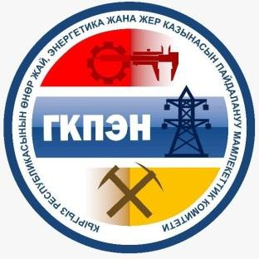
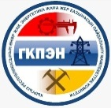
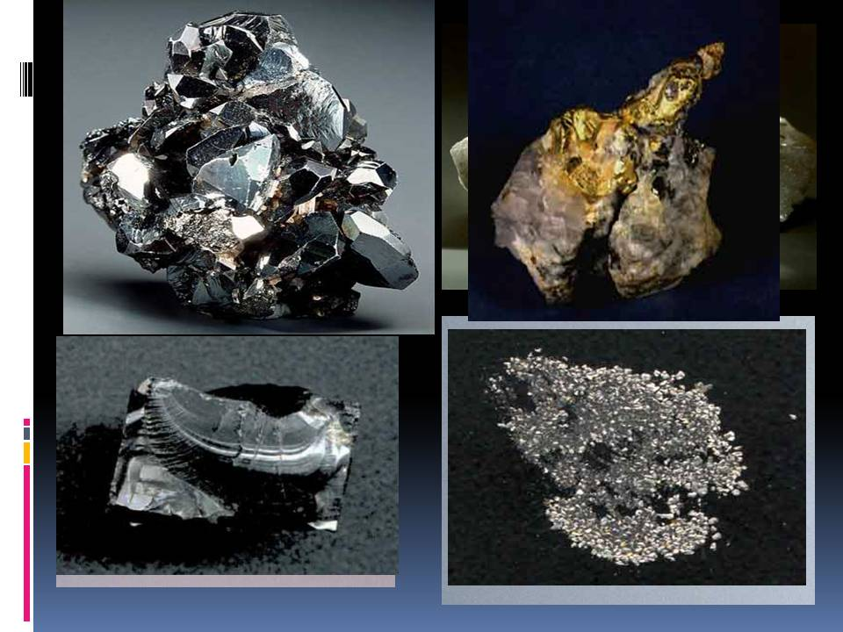
Mineral potential of the Kyrgyz Republic
The state balance of mineral resources lists about 200 deposits with fully explored or actively explored reserves of mineral raw materials.
Particular importance is attached to the reserves of gold, rare and rare-earth metals, as well as non-metallic mineral resources, the development of which can significantly increase the country's gross domestic product (GDP) and tax revenues to the state budget.

Slide 7
Prospective reserves and forecasted resources of metals and minerals
Type of mineral resource | Number of deposits | Reserves and forecasted resources
Iron | 12 | 1791.4 million tons
Aluminium (bauxite) | 10 | 47067.9 thousand tons
Aluminium (nepheline syenites) | 2 | 405,403 thousand tons
Copper | 29 | 6470.3 thousand tons
Lead | 27 | 912 thousand tons
Zinc |  | 452,9 thousand tons
Tin | 14 | 277,7 thousand tons
Tungsten | 20 | 276.2 thousand tons
Molybdenum | 18 | 106 thousand tons
Mercury | 29 | 48,3 thousand tons
Antimony | 33 | 770,8 thousand tons
Rare earth | 11 | 75,1 thousand tons
Vein gold | 70 | 2123,7 thousand tons
Placer gold | 63 | 25,6 thousand tons
Silver | 37 | 7406,5 thousand tons
Uranium | 22 | 31,2 thousand tons
Map of metals and minerals of the Kyrgyz Republic
Symbols
Iron
Aluminium (bauxite)
Aluminium (nepheline syenites)
Rare Earth and Scattered Elements
Gold Copper
Tungsten
Silver
Uranium
Lead
Zinc
Tin
Molybdenum
Mercury
Mercury, antimony
Antimony
Gold
Gold, copper

Slide 8
Map of metals and minerals
Iron
Aluminium (bauxite)
Aluminium (nepheline syenites)
Gold
Copper
Tungsten
Silver
Uranium
Lead
Zinc
Tin
Molybdenum
Mercury
Mercury, antimony
Antimony
Gold
Gold, copper

Slide 9
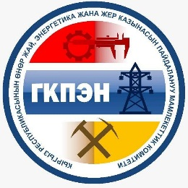
Distribution of licenses
The total number of licenses for the right to use subsoil- 2571
Exploration
Gold
Metals
Coal
In total, 1140 licenses were issued for non-metallic mineral resource, of which 717 were issued for sand and gravel mix and Loam soils

Slide 10
The main directions of development
1 | Gold mining
2 | Non-ferrous and rare metals mining (mercury, antimony, tin, tungsten, rare earths)
3 | Coal, oil and gas, production of non-metallic minerals, groundwater for domestic consumption

Slide 11
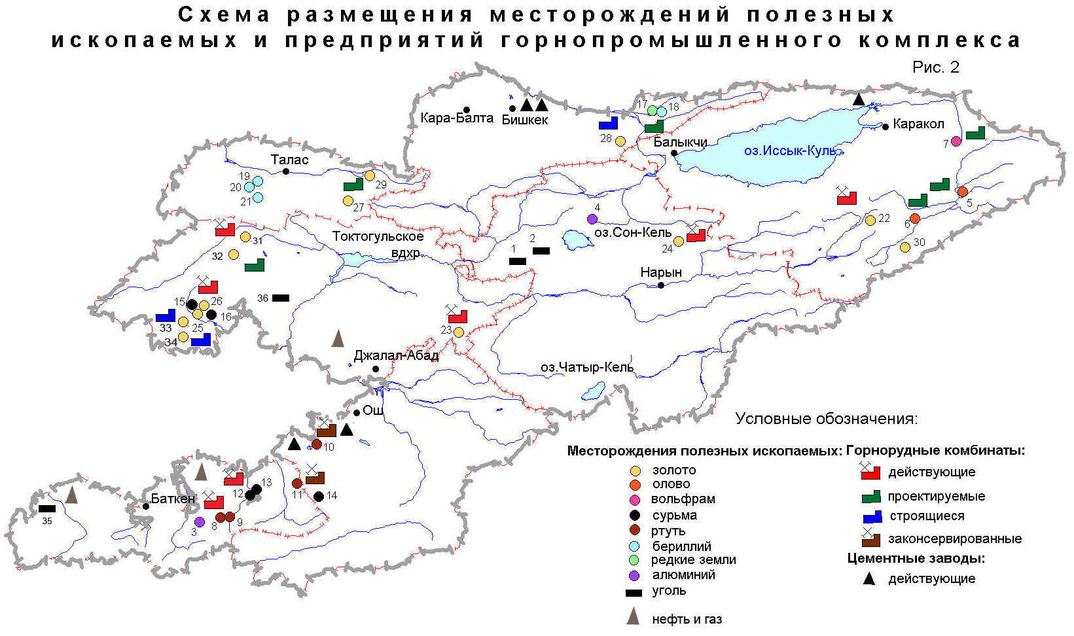
Major Gold Deposits
Jerui 75 tons(100t)
Taldybulak left-bank 95 tons
Taldybulak -8 tons(80)
Andash 27 tons
Kumbel 10 tons
Chaarat 20 tons (200t)
Togolok 46 tons
Kumtor 316 tons
Bozymchak 18,8 tons
Tereksai (80 tons)
Makmal 16 tons
Symbols
Mineral Deposits
Mining Plants
Gold Tin Tungsten Antimony Mercury Beryllium Rare-Earth Elements Aluminium Coal
Operating
Projected
Shambesai 6 tons (30t)
Under construction
Suspended
Cement Plants
Altyn-Djilga 8 tons
Working
Алтын-Джилга
Oil and Gas

Slide 12
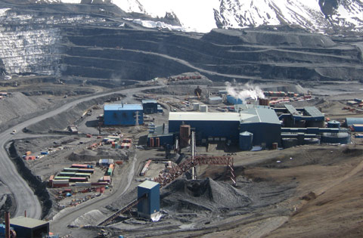
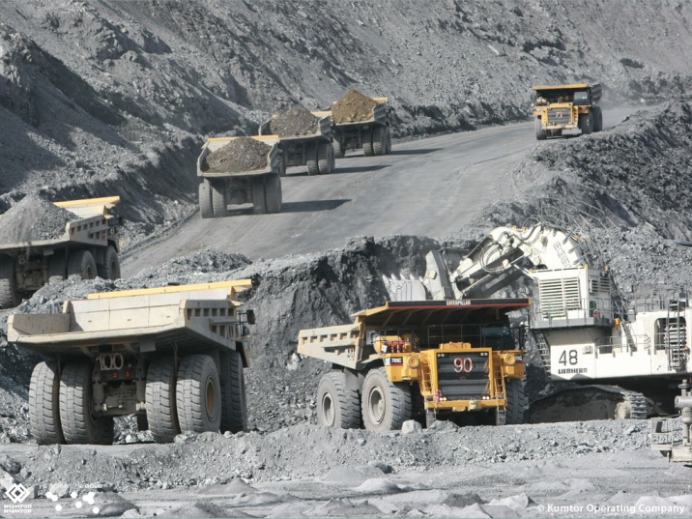
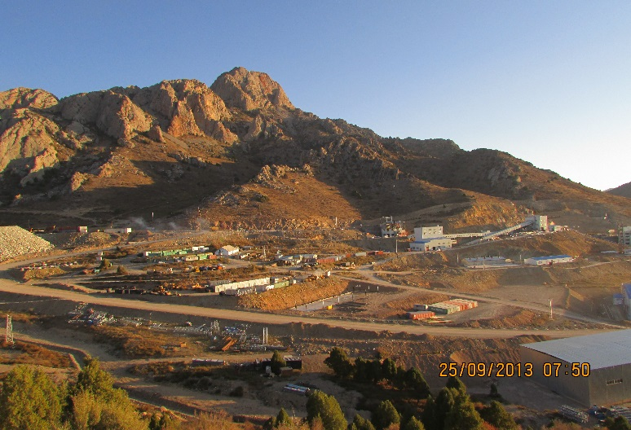
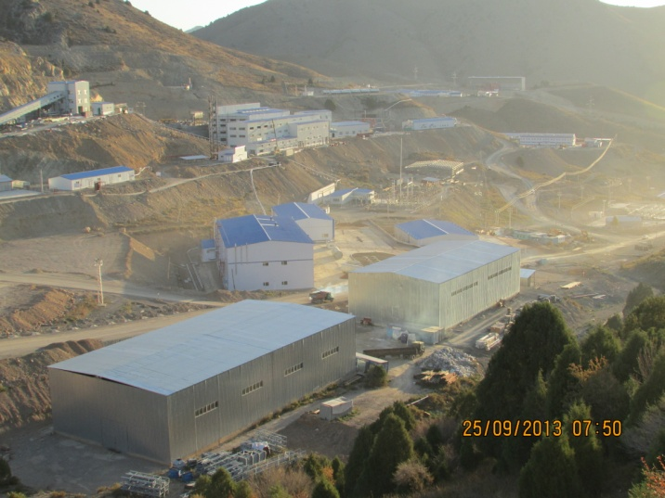

Slide 13
Gold Production
Solton-Sary
Terekkan
Mcmal
Kumtor

Slide 14
Commissioning new deposits into operation
Short term 2019-2020 year | Medium term 2021-2023 year | Long term 2024-2025 years
Kuru-Tegerek (Au – 39,2 tons) | Buchuk (Au – 12,1 tons) | Andash (Au – 19,5 tons)
Jerui (Au – 105 tons) | Tyulkubash(Au – 20,3 tons) | Togolok (Au – 17,3 tons)
Terekkan- Perevalnoe-Terek(Au – 16,4 tons) | Shiraljin (Au – 5,6 tons) | Nasonovskoe (Au – 5,6 tons)
 | Shambesay (Au – 7,8 tons) | Kyzyltash (Au – 39,5 tons)
 | Makmal (Au – 5,0 tons) | Kichisandyk(Au –27 tons)
 | Kumbel (Au – 1,2 tons)
 | Altyn-Djilga(Au – 7,1 tons)
Total: 328,6 tons

Slide 15
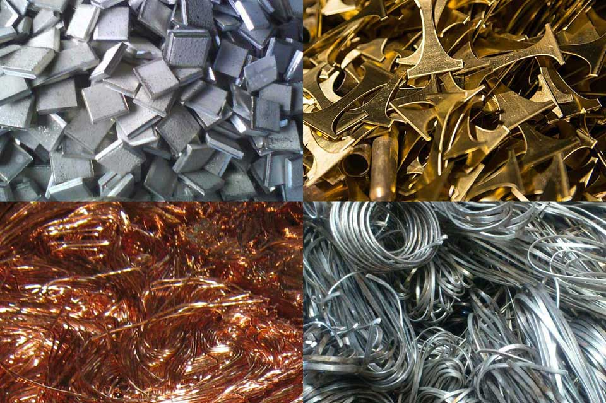
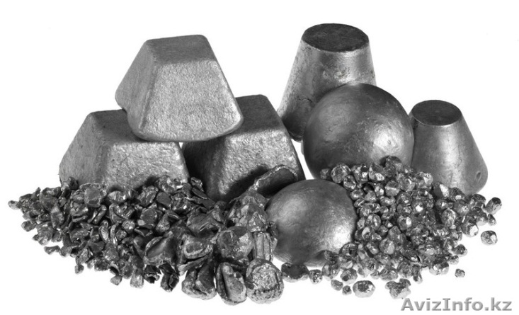
Extraction and processing of non-ferrous, ferrous, rare and other metals
Mining of non-ferrous and rare metals
Prospects for the development of non-ferrous metallurgy are associated with the construction of mining enterprises at the Trudovoye, Uch-Koshkon and Kensu tin and tungsten deposits.
Mining of ferrous metals
According to the state balance sheet, 978 thousand tons of iron ore reserves at the Nadir deposit are mined as an additive in the production of cement for South Kyrgyz Cement CJSC and Southern Construction Materials Plant LLC. Explored geological reserves of the deposit in C1 + C2 categories are 17.3 million tons of ore with an iron content of 37.5 - 42.2%.

Slide 16
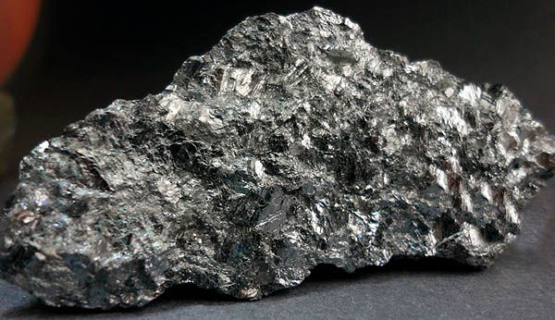
Mining and processing of ores of non-ferrous, ferrous, rare and other metals
Antimony production
Mercury mining

Slide 17
Oil Production

Slide 18
Coal Mining
Coal mining has been conducted intermittently for more than 100 years at the Kok-Zhangak, Tash-Komur, Sulukta and Kyzyl-Kiya deposits

Slide 19
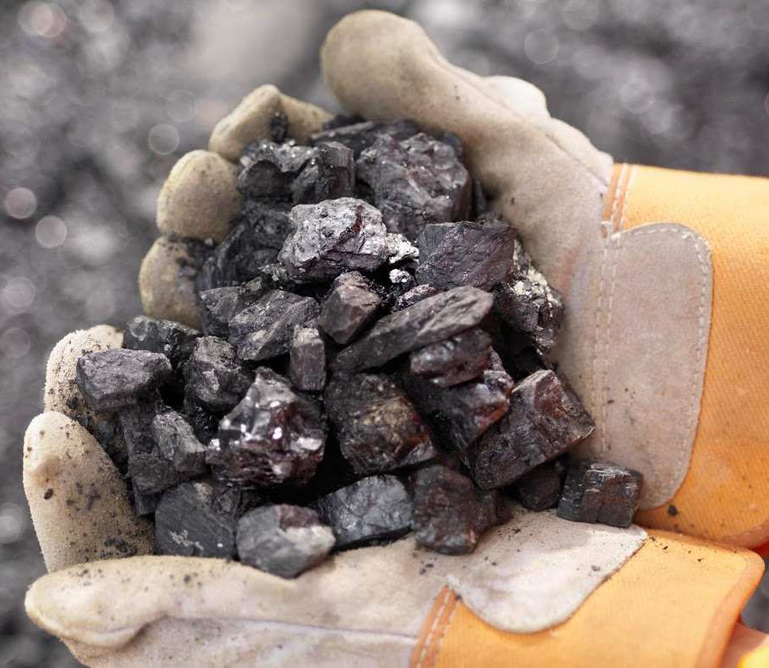
Coking coal Mining
The Uzgen basin in Kyrgyzstan has the largest reserves of coking coal and includes 17 deposits.
At the Tuyuk-Kargasha deposits in the Uzgen district of the Osh region and Kok-Kiya in the Toguz-Torous region of the Jalal-Abad region, the estimated resources are 275 million tons.

Slide 20
Extraction of non-metallic industrial raw materials and raw materials for the production of building materials
The country's mineral and raw material base fully covers the needs for the production of building materials, taking growth into account.
In Kyrgyzstan, more than 200 enterprises mine 15 different types of non-metallic mineral resources, mainly construction materials.

Slide 21
Mining taxation
Tax Type | Rate | Where is credited
Income tax | 10% of profit | republican budget
Gold Mining Income Tax | Rate from 1% to 20% (depending on gold prices) | republican budget
Interest tax (for legal entities) | 10% of interest paid | republican budget
Income tax of foreign organisations not associated with a permanent establishment in the Kyrgyz Republic | 5% of the cost of services, 10% of dividends, interest income, royalties, royalties, cost of services / work, etc. | republican budget
Value Added Tax (VAT) | 12% of the taxable value of supplies / imports | republican budget
Sales tax | From 1% to 3% depending on the type of supply and the status of the entity | republican budget

Slide 22
Mining taxation
Tax Type | Rate | Where is credited
Bonus | By types of mineral resource according to classification tables | republican budget
Royalty | From 1% to 12% (depending on the type of mineral resource and reserves) | republican budget
 |  | 50% local budget, except gold
Land tax | The tax base is the area of land | local budgets
Property tax | The tax base is real estate and movable property | local budgets

Slide 23
Social responsibility
Non-tax payments
Type | Rate | Where are credited
Payment for retaining a license for the right to use subsoil | - area size - date of issue of the license - type of mineral | local budget
Deduction for the development of the maintenance of local infrastructure from the developers of mineral deposits | 2% of revenue excluding indirect taxes received from the sale of minerals | local budget republican budget (Regional Development Funds)
A social package in the form of an agreement between a subsoil user and local communities in accordance with which the subsoil user provides material, social and other support to local communities living in the location of the subsoil use facility.

Slide 24
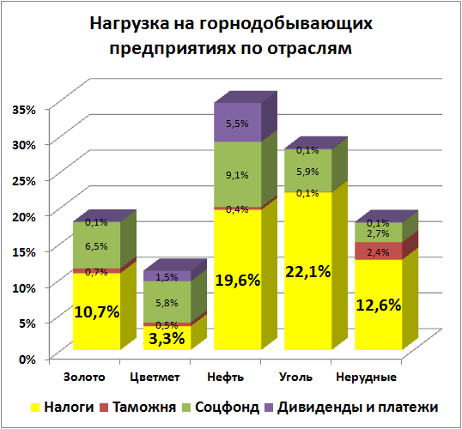
Burden on Mining Companies by Industry
Gold
Non-Ferrous Metals
Oil
Coal
Non-Metallic
Tax
Customs
Social Fund
Dividends and Payments

Slide 25
Granting the rights to subsoil use
Grounds
Validity period
3 years with extension up to 2 years
License
Geological prospecting
Competition
Auction
4 years renewable up to 3 years
Geological Exploration
“First come – first serve” Rule
for the selection and use of groundwater - up to 10 years with the possibility of subsequent extension
up to 20 years - until depletion
Resource development
СРП

Slide 26
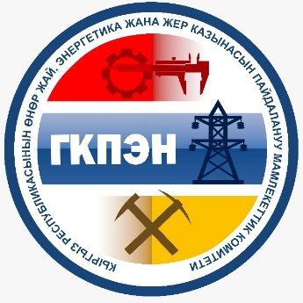
1. First submitted application
3
2
1
1
transparent licensing procedure
2. Disclosure of information on ultimate beneficiaries
the fight against money laundering and the financing of terrorism
elimination of a possible conflict of interest

Slide 27
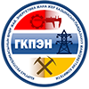
4. Publication of current licenses and license agreements
openness and transparency
access to the information

Slide 28
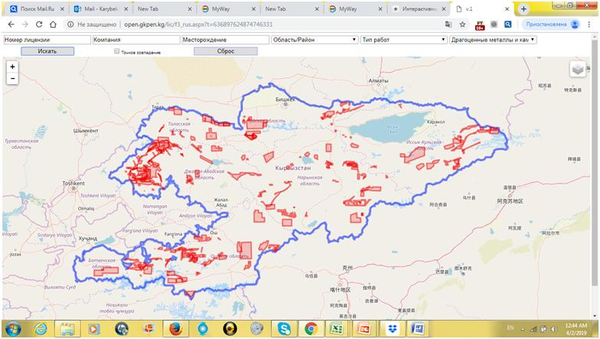
Gold Licensed Area Card

Slide 29
Planned tenders for 2019-2020
№ | Name and type of mineral | Mineral reserves
1 | Coal deposit of Tegene, with the aim of developing and conducting exploration | 56 million tons
2 | Brown coal deposit Sulukta-field 11, with the aim of developing and conducting exploration | 82 million tons
3 | The Naukatskoye gypsum deposit, with the aim of developing and conducting geological exploration | 16 million tons
4 | Kadamzhay antimony field, with the aim of developing and conducting geological exploration | 105 million tons
5 | Tuyuk-Kargasha coking coal deposit, with the aim of developing and conducting geological exploration | 175 million tons

Slide 30
Thank you
for your attention!

