Slide 1
KOCAELI CHAMBER
OF INDUSTRY
JUNE 2023

Slide 2
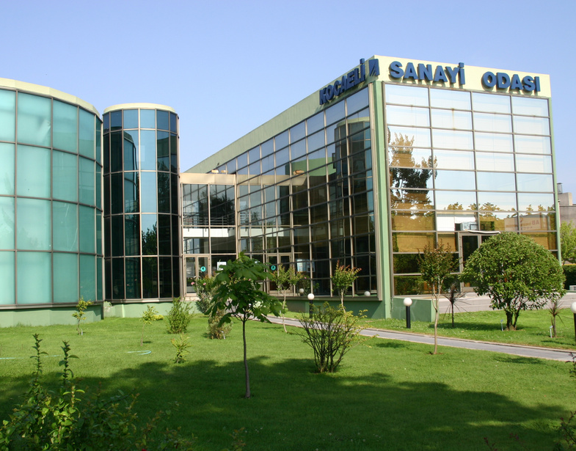
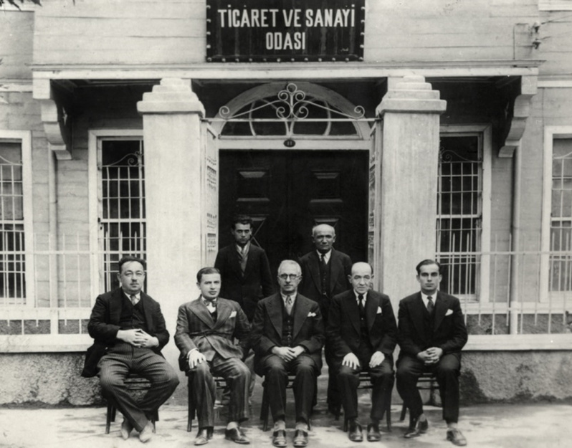
About Us
From Past
The Kocaeli Chamber of Industry was founded in 1897 as a Chamber of Commerce and Industry
To Present
Today with its 31 employees it serves approximately 3585 member companies

Slide 3
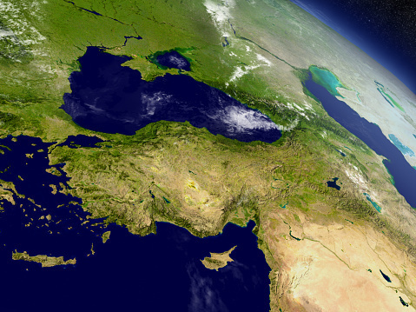
INDUSTRIOUS HEARTHLAND KOCAELI
Population 2 Million 2022
1
8th Smallest Province In Turkiye
2
3
%10,07 of National Tax Revenue Collected
84 of Turkiye’s Largest Companies are Located Here
4

Slide 4
LOGISTICS
AIRWAY
Sabiha Gokcen Int. Airport: 50 km.
Cengiz Topel Airport: 10 km.
HIGHWAY
TEM Motorways and D100 Main Road
RAILWAY
Highspeed Train
MARITIME
35 ports and industrial facility docks

Slide 5
MAIN SECTOR SHARES IN KOCAELI
MANUFACTURING
Automotive Industry
%40.7
Other Cities
%13
Kocaeli
Chemical Industry
%27
Basic Metal Industry
%19.7

Slide 6
FOREIGN TRADE VALUES
% 17.6
2022 Billion USD | KOCAELI | TURKIYE | %
EXPORT | 37.7 | 254.2 | 14.8
IMPORT | 71.2 | 364.4 | 19.5
FOREIGN TRADE VALUES | 108.9 | 618.6 | 17.6
.
.
OTHER CITIES
KOCAELI

Slide 7
FOREIGN DIRECT INVESTMENTS
Germany
68
France
29
Nerherlands
25
Italy
25
South Korea
20
USA
20
UK
19
Switzerland
15
Japan
14
Austria
12
Spain
8
Belgium
8
Russia
5
Others
62
0
25
50
75
330 FDI in Total

Slide 8
LEADING COMPANIES

Slide 9
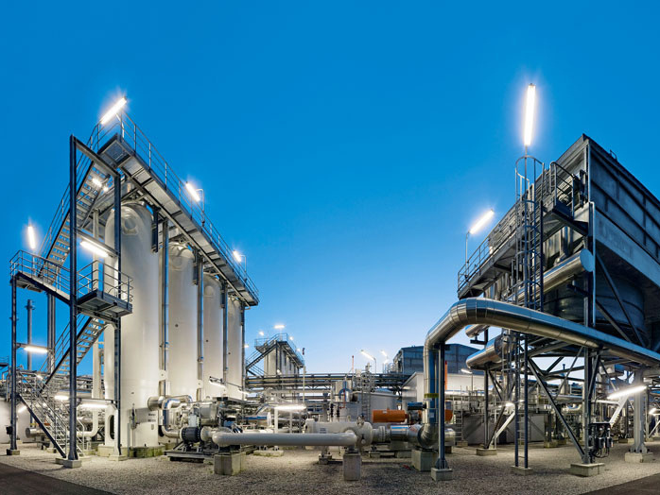
INDUSTRIAL HIGH POTENTIAL
14
2
5
2
Organized Industrial Zones
Free Trade Zones
Technoparks
-415 companies
-6752 employees
Research Institutes
Turkiye's Largest Research Campus TUBITAK

Slide 10
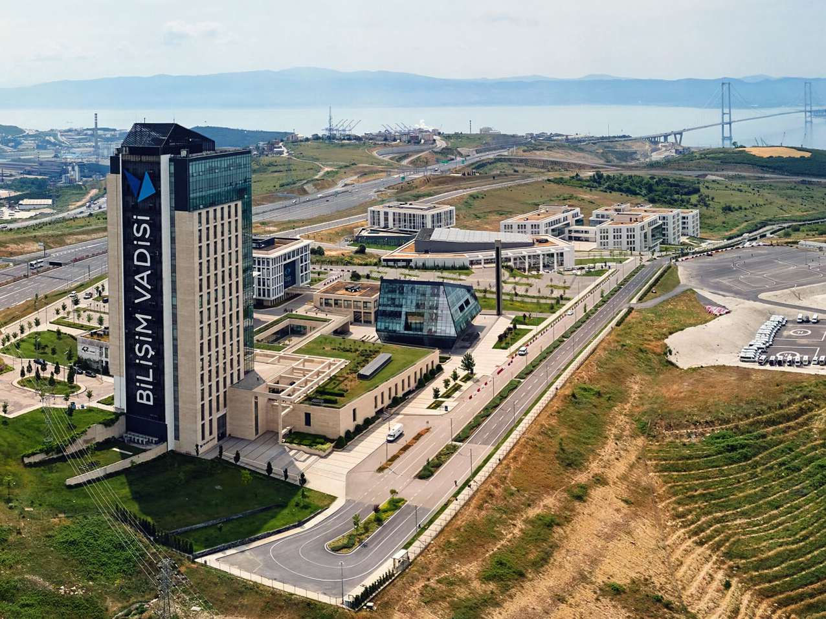
BILISIM VALLEY
IT Valley in Gebze is a technology development zone focused on Informatics in Kocaeli. As the new center of technology based development in Turkey, IT Valley will house a
“prototyping center, a sophisticated innovation center, Turkey’s largest entrepreneurship ecosystem and many visionary projects.

Slide 11
NOT JUST INDUSTRIAL FACILITIES
CONGRESS AND FAIR TOURISM
WINTER TOURISM
MANY HOTELS OF ALL STANDARTS
THERMAL TOURISM
INTERTWINED WITH NATURE
CULTURAL ACTIVITIES
WELL DEVELOPED HEALTH FACILITIES

Slide 12
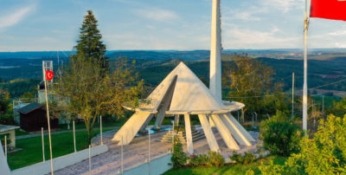
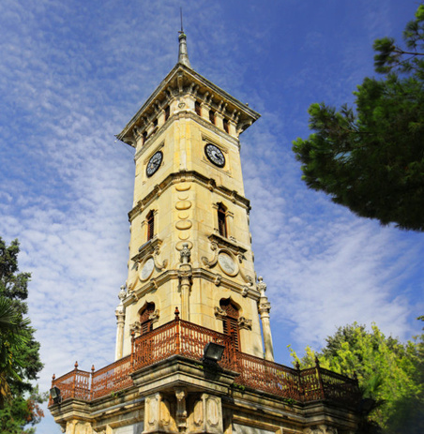
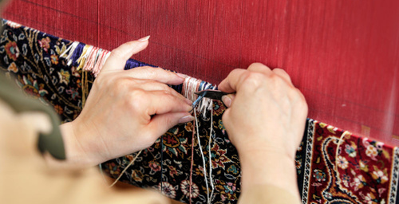
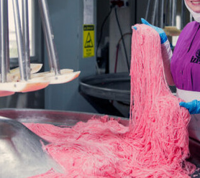
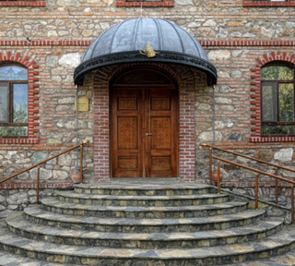
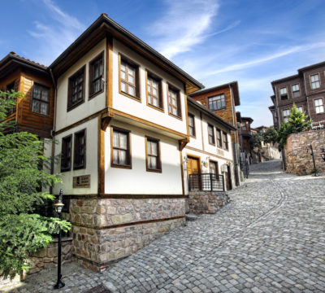

Slide 13
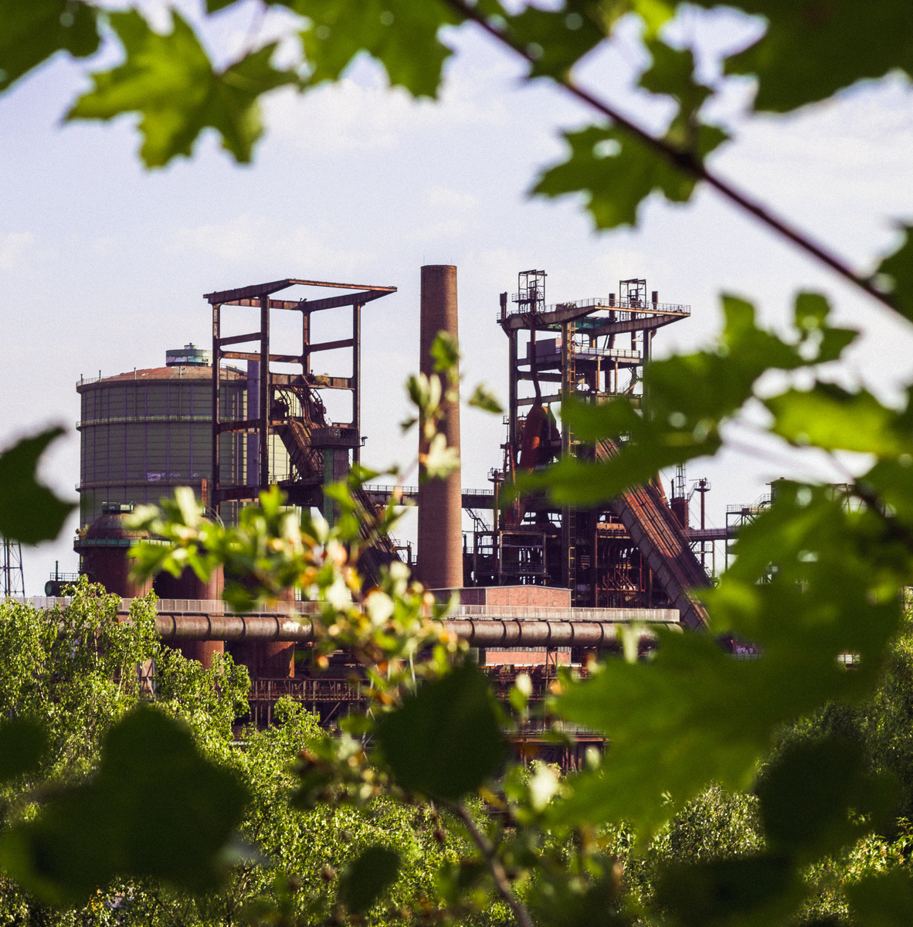
CONTACT
E-mail:
kso@kosano.org.tr
Website:
www.kosano.org.tr
Phone:
+90 262 315 80 00

Slide 14
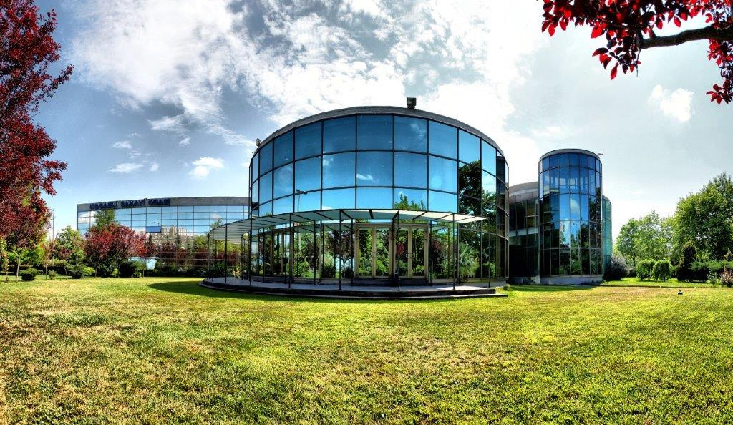
THANK YOU

