Slide 1


Slide 2
WHO WE ARE?
TIDZ is the focal point for investors seeking support to invest in North Macedonia.
15 free economic zones available with ready-to-use infrastructure and other favourable conditions.

Slide 3

Available with ready-to-use infrastructure and other favourable conditions.
Notes:
16 zoni

Slide 4





KEY FIGURES
INVESTMENT VOLUME
40 CAPACITIES OWNED BY FOREIGN INVESTORS FROM TAIWAN, GERMANY, CANADA,USA etc.
GENERATED EXPORTS
CAPACITIES
RECENT INVESTMENT DEALS
€ 3,7BN
IN 2022 (record high)
WHICH EQUALS TO
47% OF NORTH MACEDONIA’S EXPORT
2300 NEWLY CREATED JOBS ONLY IN 2022
€ 1 bn new Investment deals SINCE 2021
€ 189 M
500+ employees
Pharma industry
€ 205M
3900+ employees
Electronic components

Slide 5
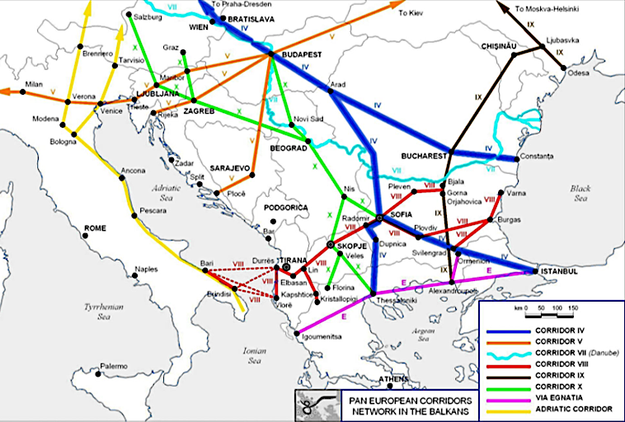
STRATEGIC LOCATION
EASY ACCESS TO
NW EUROPE, ASIA AND NORTH AMERICA
MODERN HIGHWAYS TO NW EUROPE
EASY ACCESS TO PORT OF THESSALONIKI (GR)
(236 km from SKOPJE)
EASY ACCESS TO PORT OF DURES (AL) (under construction)
(339 km from SKOPJE)

Slide 6
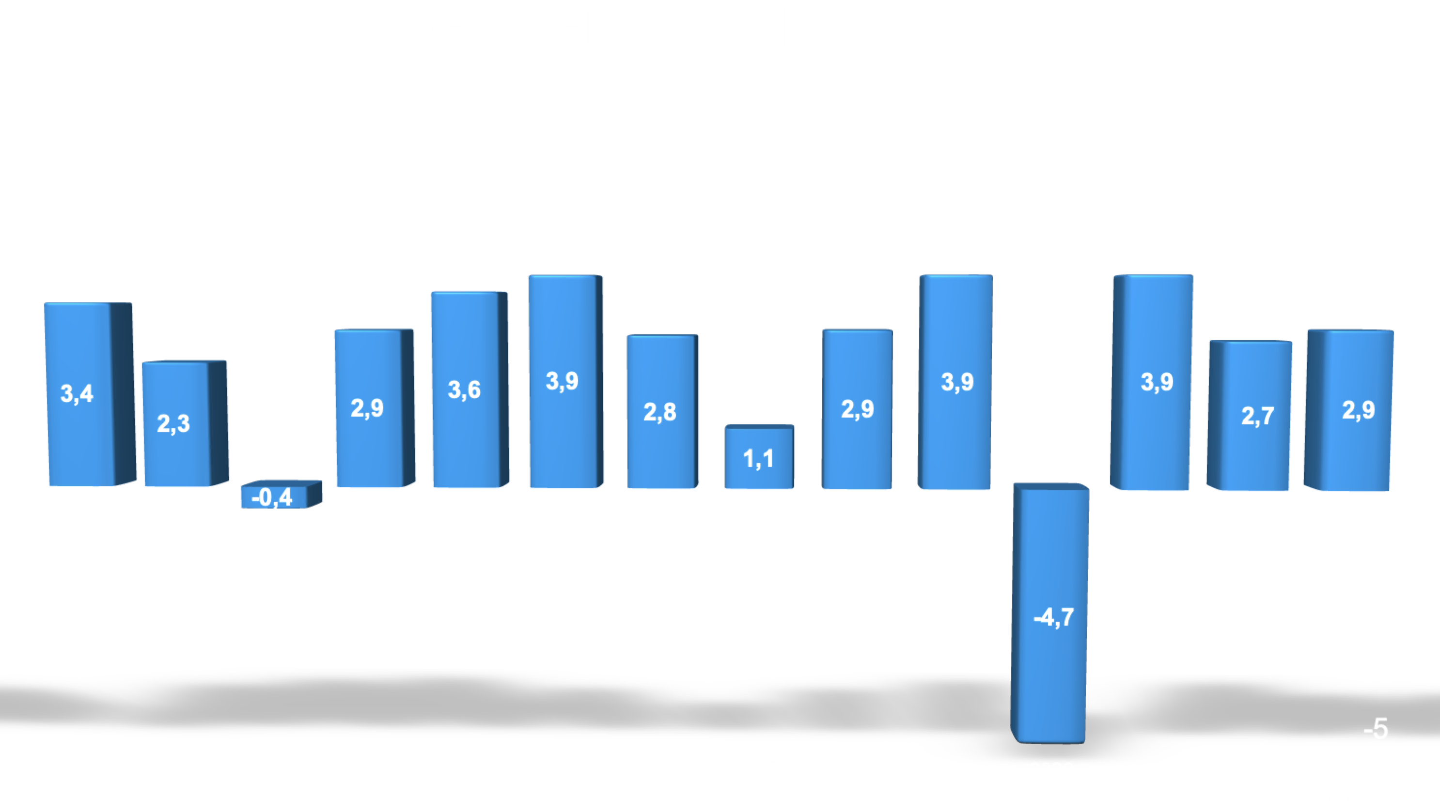
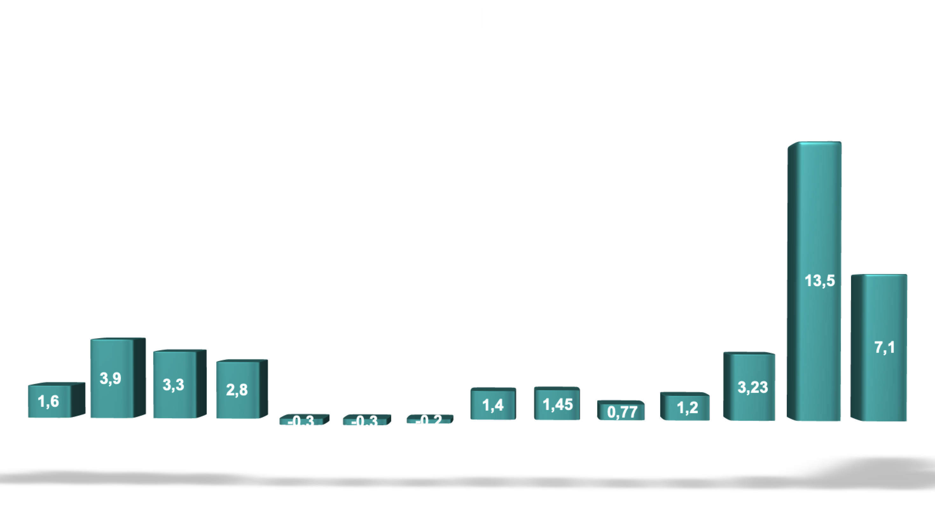
STABLE AND SECURE
NATO membership since 2020
EU candidate country since 2005
Start of the EU negotiation accession process 2022*Expected EU membership 2030
Free trade agreements enabling access to markets in 40 countries with 600 million consumers
Low inflation: avg. < 2% annually over the last 18 years

Slide 7

OUR SUPPORT TO INVESTORS

Slide 8


Slide 9
NEW APPROACH
STANDARD STRUCTURE:
10% on CAPEX + 10% on competitiveness
NEW APPROACH (FLEXIBLE STRUCTURE)
Business plan analysis (focusing on the period of return on investment for the state, structure of employees and wages, sales, profits, past records of the client)
Up to 10 years exemption from (or paid subsidies) personal and income tax
Maximum cumulation: up to 50% of eligible investment costs
Flexibility in contracts (encouraging investors for larger projects; no min investment required, no penalties for failing to meet targets in investment plans)
Shortening the CAPEX payment period and competitiveness (investment period + 1)
Increasing participation in cash measures vs. subsidies / exemptions in the overall structure
"Moving" limits on annual payments, depending on available budget fund

Slide 10
„SINGLE ENTRY POINT“ AFTERCARE SYSTEM
SINGLE ENTRY POINT CONCEPT
3-PILLARS SUPPORT SERVICES
Newly introduced fast track protocols with other institutions
PERSONALIZED SUPPORT
Each company has its own unique single contact person for direct communication
DIGITALIZED PROCESS
Eased procedures for construction permits etc.

Slide 11
LABOR FORCE

Slide 12

QUALIFIED LABOR SECURED
2022
Unemployment rate in North Macedonia
15,7%
77,6%
of the total number of unemployed are in the age group of 20-49

Slide 13
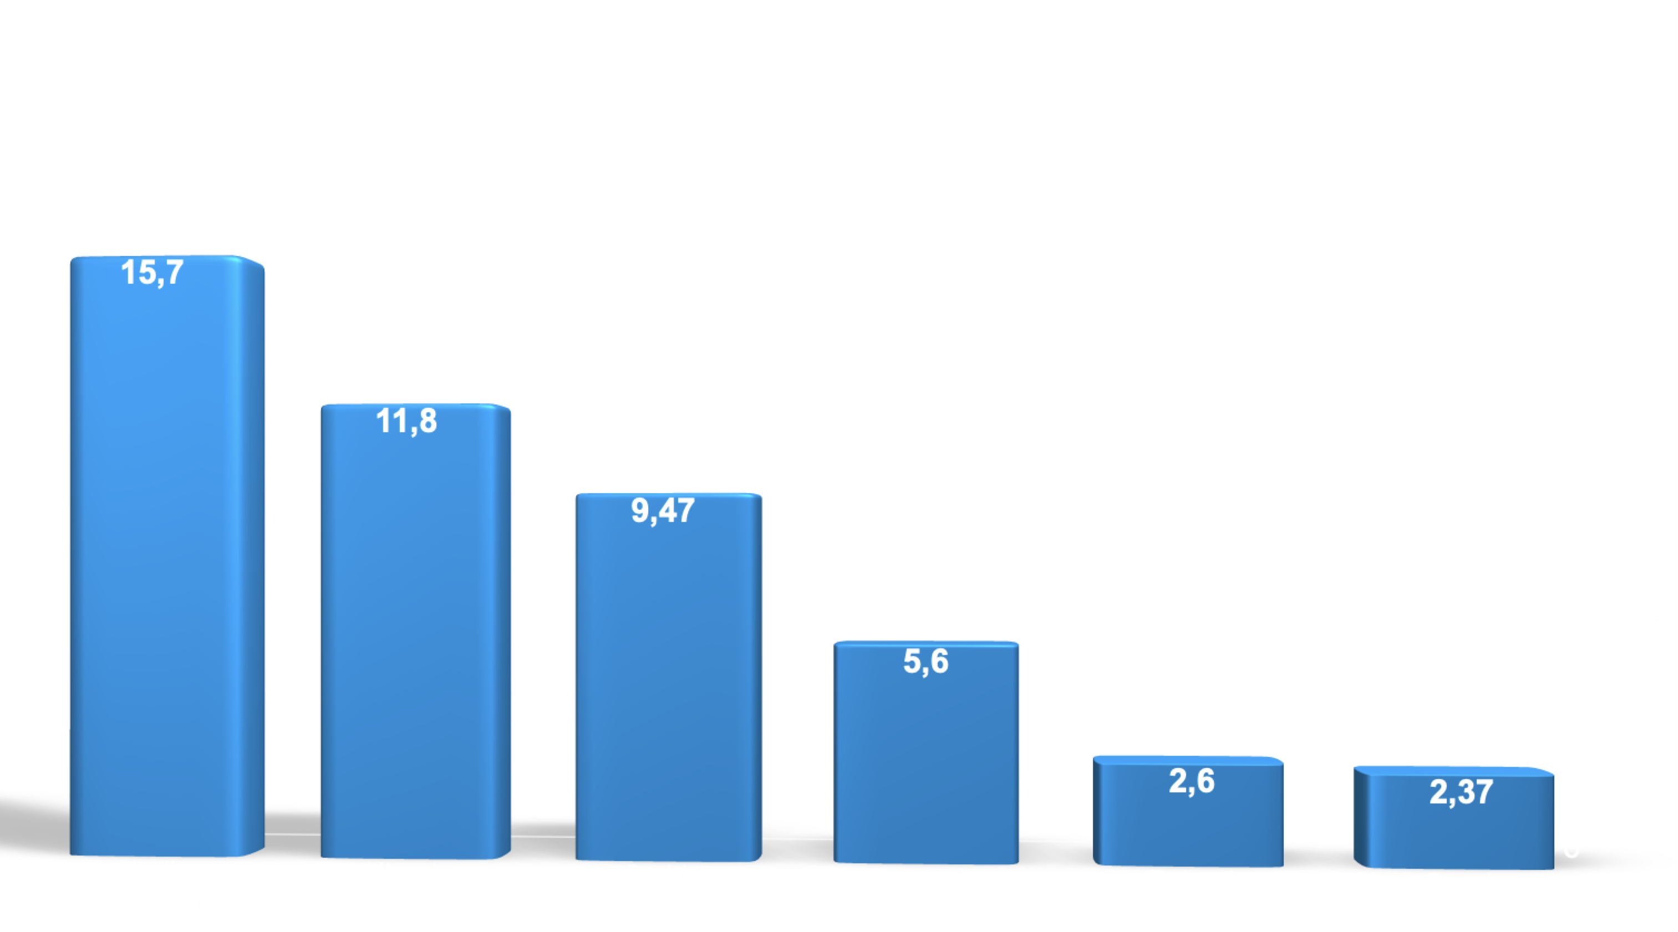
COMPARISON CEE 2021

Slide 14
COMPETITIVE LABOR COST
Average gross monthly salary (manufacturing) North Macedonia (EUR))
2012 2013 2014 2015 2016 2017 2018 2019 2020 2021 2022 2023
*Source: State Statistical Office of North Macedonia

Slide 15


AVAILABLE LOCAL QUALIFIED SUPPLIERS
Since 2021 more than 30 Macedonian companies have passed the scrutiny of the IFC and joined the Western Balkans supplier chain platform
The Government provides financial support to international investors who utilize local suppliers
(10% from the amount purchased from domestic suppliers, up to €300K p.a.)

Slide 16
INVESTMENT OPPORTUNITIES/PROJECTS

Slide 17

1st HIGH TECHNOLOGY ECONOMIC ZONE –SKOPJE III

Slide 18
1st HIGH-TECH ZONE SKOPJE III
Location: Skopje
Free Zone Skopje 3 has a direct connection with the rote E-75 Belgrade - Skopje – Thessaloniki (on the crossroads of Corridor X and Corridor 8)
Plot: 45 ha
Zone Info:
The new technological industrial zone Skopje 3 will become the first high-tech zone that will focus on advanced technologies. The goal is to bring companies or develop companies that will focus exclusively on high technologies. The Zone will function as a Public Private Partnership. The development of this Zone will be connected to the Science and Technology Park project that began in 2019 aiming to encourage scientific research at the service of companies.
Eligible Activities: focus on Hi-tech and advanced technology industries
Estimated value of the investment: 153 mil. Eur.
Potential generated investments: 860 mil. Eur.
Status: Concluded Feasibility Study – Government procedure

Slide 19

TIDZ GEVGELIJA - 1st GREEN/HEALTH ZONE IN THE BALKANS

Slide 20
1st GREEN/HEALTH ZONE IN THE BALKANS
Location: Gevgelija
direct connection with the highway E-75 Skopje – Thessaloniki and railway Corridor 10;
proximity to the Bogorodica border crossing (10 km) - connection with the Republic of Greece;
relative proximity to the Skopje airport (about 144 km highway);
Plot: 50ha (first phase) + 70 ha (second phase)
Zone Info:
The technological industrial zone in Gevgelija will become the first Green/Health investment zone in the Balkans, which will focus on supporting green industries, as well as investments in advanced technologies in the health sector and health services. The Zone will function as a public-private partnership. There is an opportunity the Zone to be financed through the model of the new Green Strategic Fund.
Eligible activities:
Implementation of green technologies
Investments in photovoltaics
Development of green and medical components in the zone
Attracting green investments
Estimated value of the investment: EUR 120 mil (first phase)
Potential generated investments: EUR 400 mil. (first phase)
Status: Completed Feasibility study – Information approved by the Government/ Public call will be opened soon

Slide 21
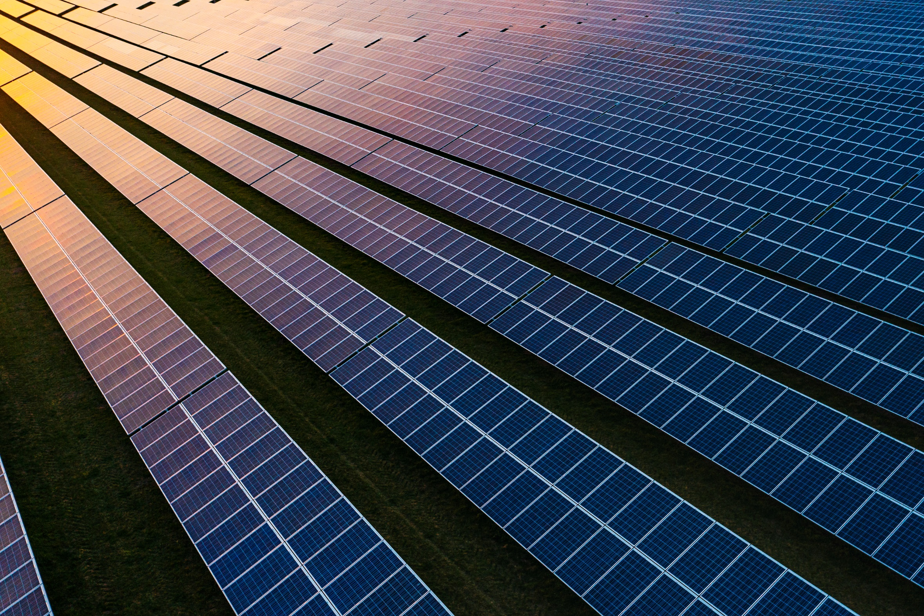
GREEN ENERGY PROJECTS

Slide 22
GREEN ENERGY PROJECTS
Location: various TID-Zones (15 currently)
Plot: 75 ha
Info:
In accordance with its concept and mission the Directorate for technological-industrial zones aims to reallocate plots of certain zones and certain zones as a whole, in plots and zones for electricity production from renewable energy sources. The land will be used for projecting, installation, financing, management and transfer of solar power plants in TID-zones.
Eligible Activities:
upgrade and increase of the electric power capacities in TID-zones using cost-effective and non-pollutive sources of energy;
utilization of (less usable) parts of building plots in TID-zones for production of electric power from renewable energy sources;
creation of new green jobs
Estimated value of the investment – EUR 50 mil. +
Potential annual revenue of EUR 4.275 mil.

Slide 23
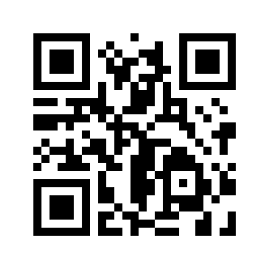
INVEST SMART

