Slide 1
AGENCY
FOR FOREIGN INVESTMENTS AND EXPORT PROMOTION
Investment
&
Trade Opportunities
November 208
23th of September, 2023
Notes:
Your Excellencies,
Dear participants,
I would like to thank you for allowing us to present the business potential and opportunities in our country, in the next 15 minutes.
Invest North Macedonia is an official Governmental investment and export promotion agency which is established in 2005.
Our mission is to encourage and support new FDI to the country, establish and enhance business cooperation with local suppliers and promote the export potential of local companies to foreign markets.

Slide 2
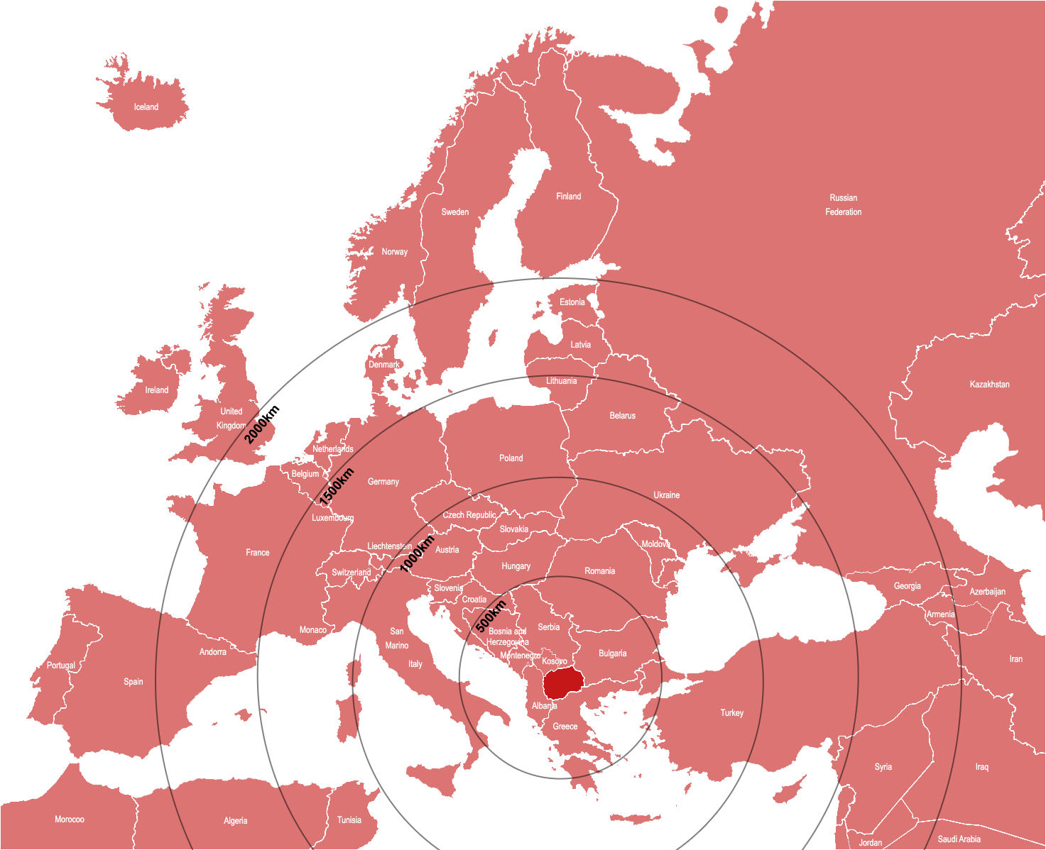
General Overview
POPULATION: 1,85 million
AREA: 25.710 sq. km
CAPITAL: Skopje (Population of 600.000)
TIME ZONE: GMT+1 hours
All of Europe in 2-3 days Via Highway Connections
Road network: 9.205 km
Railway network: 900 km
Two Pan-European Corridors:
East-West Corridor 8, North-South Corridor 10
Two international airports: Skopje, Ohrid
International ports:
Durres (Albania): 140 km. from border
Thessalonica (Greece): 80 km. from border
Free Access to Market of 680M customers:
Free Trade Agreements with
EU, EFTA, CEFTA countries +
UK, Turkey and Ukraine
Member of the World Trade Organization (WTO) since 2003
Regional cooperation initiative called OPEN BALKAN
between North Macedonia, Serbia & Albania aim to remove the borders between the countries,
for citizens and the transport of goods
by 2023.
*Price for 20 ton truck from Skopje
Notes:
The Republic of North Macedonia, previously the Republic of Macedonia, and commonly used Macedonia, is a landlocked country situated in Eastern Europe, on Balkan Peninsula.
It has well-developed infrastructure and connectivity to the rest of the world. Two major European corridors are crossing here.
Corridor 8 is connecting the Adriatic with the Black Sea and corridor 10 runs between Salzburg in Austria and Thessaloniki in Greece…… We have 2 international airports in Skopje and Ohrid.
The country offers free access to a market of €650 million customers covered with the Free Trade Agreements signed with the EU, CEFTA, EFTA countries, Ukraine, Turkey, and the UK.

Slide 3
EU and NATO
EU Candidate Country
NATO member since 2020
Notes:
Slide 3. EU and NATO
North Macedonia is a NATO member and EU membership candidate country.

Slide 4
Why Invest in North Macedonia?
Low operational costs
Excellent geostrategic location
Available competitive workforce
Fiscal benefits & Incentives
Investment friendly environment
Notes:
The first question for every investor is why I will invest my money here?
And the answer will be:
because of:
nabroj
I will point out some arguments why investing, and trade with North M. is an attractive idea.
When discussing why NM is an attractive destination for foreign companies we will emphasize the geo-strategic location at the center of the Balkan Peninsula - South Europe, Low operational and investment cost, affordable and skilled labor force, and generous fiscal benefits and incentives.
Despite the small country size and limited domestic market, NM possesses remarkable advantages for potential investors mainly by continues governmental commitment for economic growth and development of the country, and widely recognized investor’s friendly environment.
The country offers a stable economy, a flat tax system, availability of qualifies workforce, and attractive financial support for investments, up to 50% of the initial investment.
Regarding the trade opportunities with Macedonian products, you will find high-quality products, already distributed at high competitive markets worldwide, at affordable prices.

Slide 5
Macroeconomic indicators
INFLATION
Low inflation: 2013: 2,8%; 2014: -0,3%; 2015: -0,3%;
2016: -0,2%; 2017: 1,4%; 2018: 1,5%; 2019: 0,8%; 2020 : 1,2%; 2021: 3,2%; 2022: 13,5%; 2023: 7,1%
CURRENCY(Macedonian denar)
GDP PER CAPITA (€)
€1= MKD 61.5
US$1= MKD 58
AVERAGE MONTHLY SALARY 2023
Net wage €593
Gross wage €889
FDI BY YEAR (million €)
CREDIT RATINGS 2021
Standard & Poor’s: BB-
Fitch: BB+
STATE DEBT
State Debt, Q2 2023: 50.3% of GDP
Source: National Bank of the Republic of North Macedonia March 2023; Ministry of Finance, March 2023
Notes:
We have stable and predictive economic situation, confirmed with positive growth of all economic parameters.
Macroeconomic indicators on this slide show the trends of the most important economic indicators in the last 10 years.
We have a stable economy with low inflation, with the peak last year, obviously due to the crisis in Ukraine.
The Macedonian denar is pegged €1= MKD 61.5

Slide 6
Fiscal Benefits
Average
Gross Monthly Salary in €
Personal
Income Tax (%)
Corporate Income Tax (%)
General VAT Rates (%)
Source: Trading Economics, May 2023
Source: State Statistical Office, May 2023
Notes:
We face fierce competition as a country competing to attract FDIs.
This slide is showing а comparison with top competing countries in attracting FDI’s regarding some fiscal benefits.
Citaj ponatamu – nabroj…

Slide 7
Sustainable Work Force Supply
Unemployment rate: 14 %
Average monthly net wage (7/2023): € 593 Average monthly gross wage (7/2023): € 889
Manufacturing: Net wage (7/2023): € 503
Manufacturing: Gross wage (7/2023): € 752
National statutory minimum net salary
(2023 I): € 328
Social Security Contribution Structure
Social Security Contribution
Source: State Statistical Office, Republic of North Macedonia, August 2023
(%)
Excellent language skills
Source: Trading Economics, June 2023
Notes:
Prvo citaj pa…
Unemployment rate is…
All this data shows that we can provide our new investors with sustainable and competitive work force

Slide 8
Ease of Doing Business 2020
17th Ease of doing business
Based on the World Bank’s Doing Business Report 2020
Notes:
Slide 9. Ease of Doing Business 2020
Due to the favorable business environment, we receive a lot of accolades. I will point out that we are in 17th place for Ease of doing business, Based on the World Bank’s Doing Business Report 2020, which puts us high in front of all our close competitors in attracting FDIs.

Slide 9
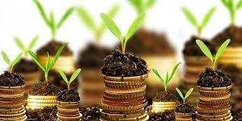
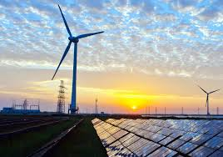
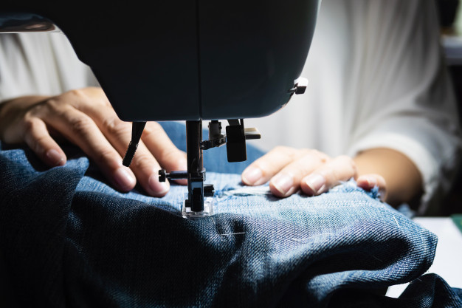
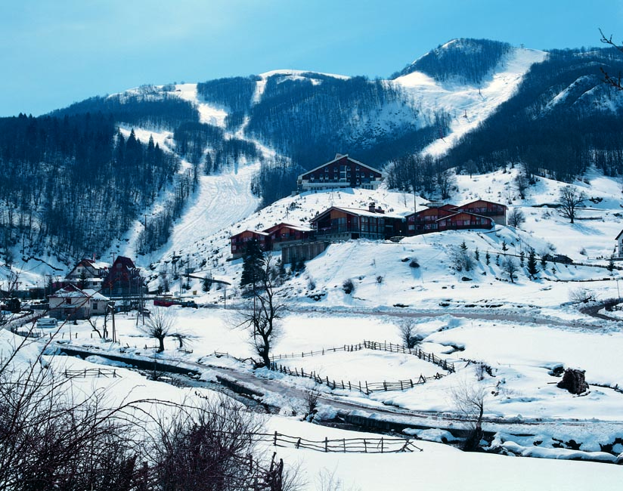
Investment Opportunities
ICT
Machine and Automotive components
Agribusiness and Food Processing
Wine industry
Healthcare Sector and Pharmaceuticals
Textile
Energy
Tourism
Notes:
The country offers attractive investment and trade opportunities. These are the sectors that we believe are the most competitive:
ICT, Machine and Automotive components, Agribusiness and Food Processing, Wine Industry, Textile Industry, Pharmaceuticals and Medical Devices, Energy, and Tourism.

Slide 10
ICT Sector
Fastest growing sector - growth rate 71% in the last 3 years
Quality software & IT services & superior technical and business know-how at competitive prices
Excellent supply of well-educated IT experts (among the lowest labor costs in the region).
Best telecommunication networks in the region – the system is 100% digital
Leading multinational hardware and software suppliers (Microsoft, HP, IBM) have local sales and support services
Well-developed educational system. More than 80 high schools with an intensive focus on languages, mathematics,
and science as well as 22 universities.
North Macedonia can be your solution!
Notes:
The average salary of different profiles in the ICT sector in the country is about 60% lower compared to the EU average,
56% of the companies are concentrated within the “Software and IT Services” sub-segment and 27% in “ICT Trade and Manufacturing”
The Macedonian ICT industry operates in 60 countries worldwide.
2022 is the first time so far that the export of ICT services exceed the value of the export of food and Agricultural products from Macedonia, which is traditionally agricultural land and land with great potential for food production.
The export is growing continuously from 150 million euros in 2016 to 308,5 million euros in 2020, but more impressive is the growth of export in “Software and IT Services”sub-division from 96,6 million euros to almost 300 million euros in the same period.
Currently, about 2020 2183 (2021 y.) companies operating in the ICT Industry, which generate a total of 879,65 million euros in revenue. There is a high probability that in the next 2 years the revenue will reach nearly 1 billion euros with 134 million net profit.
56% of the companies are concentrated within the “Software and IT Services” sub-segment and 27% in “ICT Trade and Manufacturing”

Slide 11
Machine and Automotive Components Sector
Emerging as a potential hub for automotive components production and bus manufacturing;
North Macedonia can claim relevant engineering and manufacturing capabilities, which are a legacy of the automotive component supplier’s network for the Zastava plant in Serbia since the 1960s;
Availability of a low-cost skilled workforce, supported by the modernization of the scientific higher education system;
Companies primarily supply the aftermarket
All of Europe in 2-3 days via highway connections;
A large pool of logistic companies provide competitive transportation costs and delivery times;
The duty-free market of potentially 650 million customers.
Particularly suitable for the high value added products with labor-intensive manufacture
Notes:
When talking about the industry of automotive components we must mention that the relevant engineering and manufacturing capabilities are a legacy leading us back to the 1960s.
North Macedonia had a developed automotive supplier network for the Zastava plant in Serbia (which made and still makes vehicles under FIAT license)
This is now modernized and supported via a well-organized educational system, thus making our country attractive destination for high-value-added products with labor-intensive manufacturing.
As a result of this, most of the FDI’s in the Free economic zones are coming from the automotive sector.

Slide 12
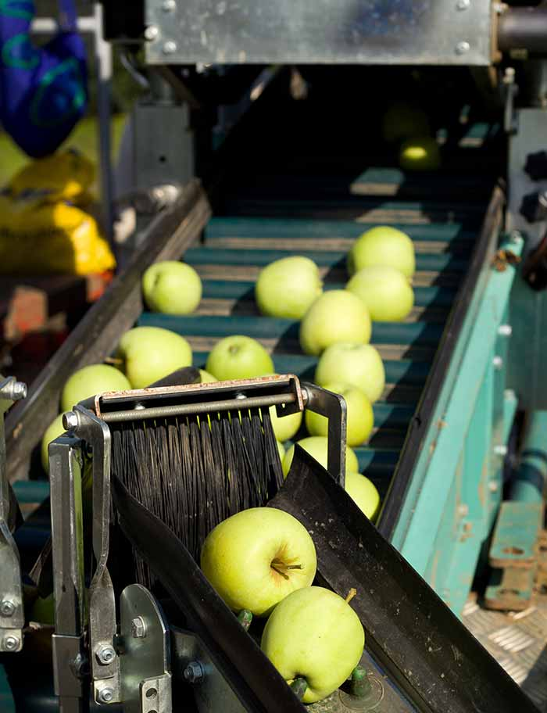
Agribusiness & Food Processing Industry
High performance sector. The agribusiness industry development is rated with +10.2% in the last three years
The mix of the Mediterranean and Continental climate offers excellent condition for top quality products
EU Standards applied. Introduction of both GLOBALGAP and HACCP as national standards
Diversified products. A variety of tastes of agricultural processed products
Excellent access to regional markets
The greatest investment opportunities: fruits and vegetables, wine grape production, sheep and goat cheese production, industrial crops & oriental tobacco
Notes:
The Agriculture, Forestry, and Fisheries sector participated in the GDP structure with 8.1% in 2019 and 8.6% in 2020.
It involves 11.5 % of the active working population.
The great natural preconditions and an existing tradition enriched with newly developed skills create a variety of opportunities in agriculture.
The agribusiness industry in North Macedonia is one of the fastest-growing industries with an over 10% increase in the last years
The Government considers agriculture a target area for future investment, growth, and development, including increased foreign direct investment.
Fresh fruit and vegetable production comprises 45.8 percent of agriculture output in the country and is export-oriented.
The food processing industry in North Macedonia consists of about 50 companies with a processing capacity of approximately 180,000 tons of fruits and vegetables per year.
The industry is export-oriented, with over 80 percent of production going to the EU and neighboring markets as fresh semi-product for further processing.

Slide 13
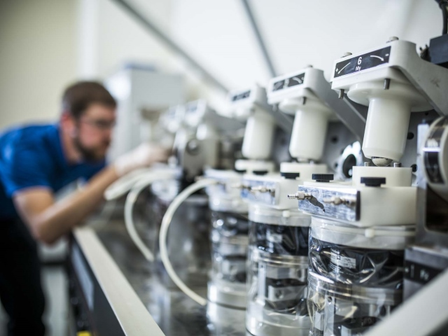
Healthcare Sector & Pharmaceuticals
Existing pharmaceutical industry, exports to over 30 countries worldwide
Strong educational system, with an abundance of medical and pharmacy graduates
Supportive regulatory environment
Licensing arrangements in place with many of world’s leading pharmaceutical companies
Available sites at industrial and free economic zones
Manufacturing tradition
North Macedonia is one of the few countries in the world
that legalized production of medical cannabis
Notes:
There is a long tradition in the pharmaceutical sector in the country. The biggest domestic pharma company Alkaloid has more than 80 years of tradition. With 18 subsidiaries and 2 rep-office…all around the world.
The Republic of North Macedonia is one of the few places in the world where the cultivation and export of medical cannabis are allowed, thus, opening its doors to investors.
North Macedonia legalized the growth of marijuana for medicinal purposes on February 9, 2016.
The Macedonian pharmaceutical market is currently valued at over €145.6m per annum and we import over 50% of the medical products.

Slide 14
Textile & Clothing Industry
27% of all employees in the manufacturing sector
The high-quality standard of Macedonian personnel with attractive costs
Highly modernized production plants
Short transportation/delivery times
Good geographic location and favorable economic conditions
Operating costs among the lowest in Europe and Eastern Europe
2nd biggest industrial sector of the country
Notes:
The textile industry participates with about 13% of the total domestic gross product (GDP), is export-oriented, and participates with 27% of the Macedonian exports.
Over 90% of exports go to countries in Western Europe such as Germany, Holland, Great Britain, and Greece.
About 35,000 workers are employed in this industrial branch, which represents approximately 27% of all employees in the manufacturing sector or about 6.7% of the total number of employees in the country.
The biggest part of the companies (over 90%) work according to the Lon production system, while only 10% can offer a full package of services.

Slide 15
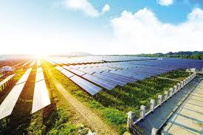
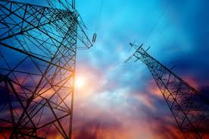
Energy Sector
North Macedonia is a ranked first in the region of Western Balkan in in terms of progress in fulfillment of energy reforms
Government strongly committed to developing the energy sector through public and private investments
National strategy based on diversifying the sources and types of energy use
Potential for hydro, solar and wind energy projects
High intensity of solar radiation, more than 2000 solar hours per year
Notes:
This is one of the best prosperous industry sectors for the Macedonian economy.
North Macedonia is ranked first in the region of Western Balkan in terms of progress in the fulfillment of energy reforms.
Energy market developments in the country included further construction of an internal gas distribution network, continued liberalization of the electricity market, and increased regional cooperation for electricity and gas interconnections.
In this time of energy crisis, we are welcoming investors in renewable energy projects and believe that the high intensity of more than 2000 solar hours per year is promising data for fruitful investment.
30 % of our total electricity production comes from renewable sources and our target is to exclude coal usage as a resource until 2035.

Slide 16
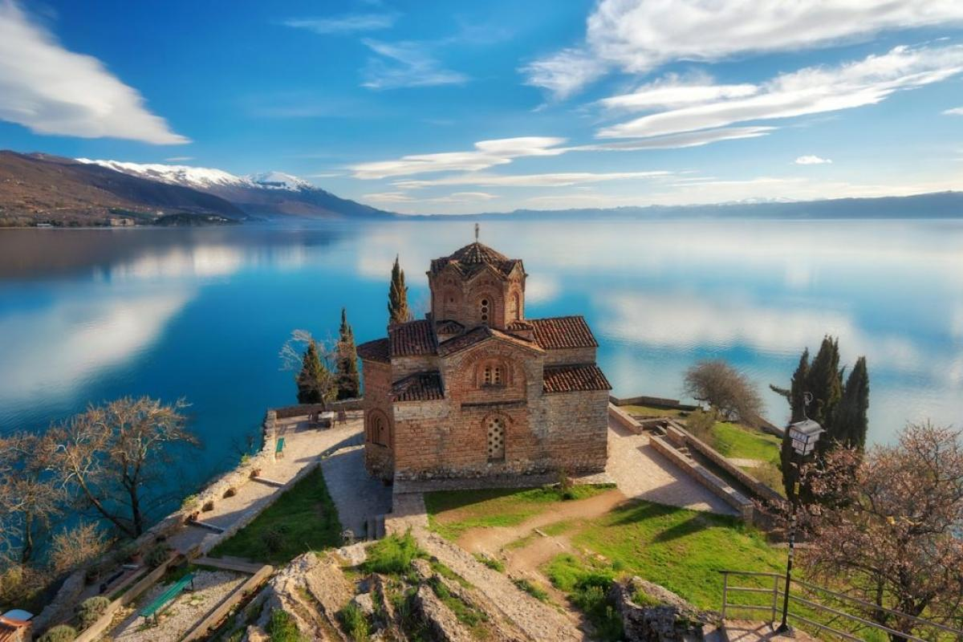
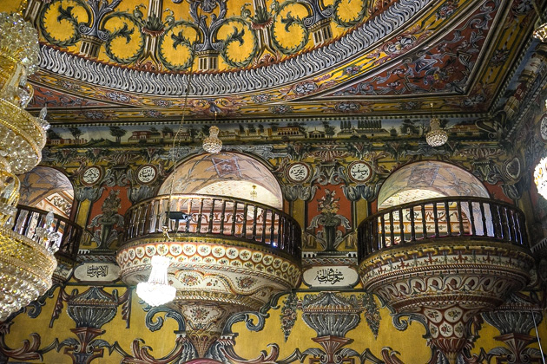
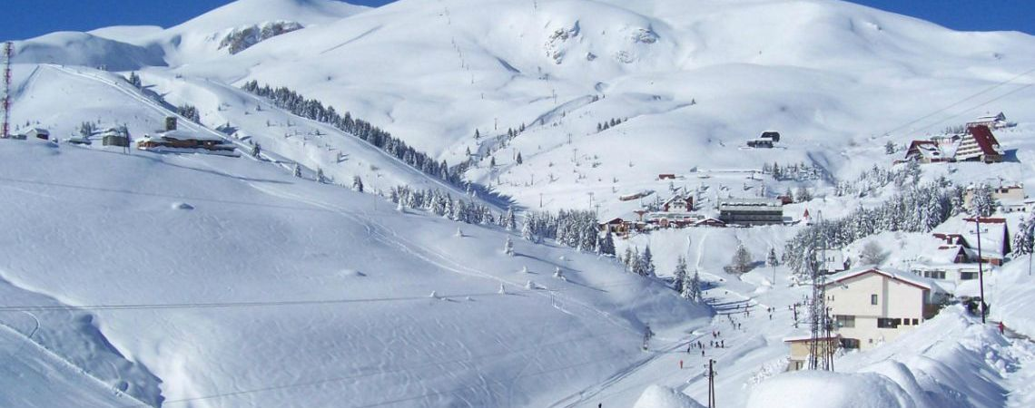
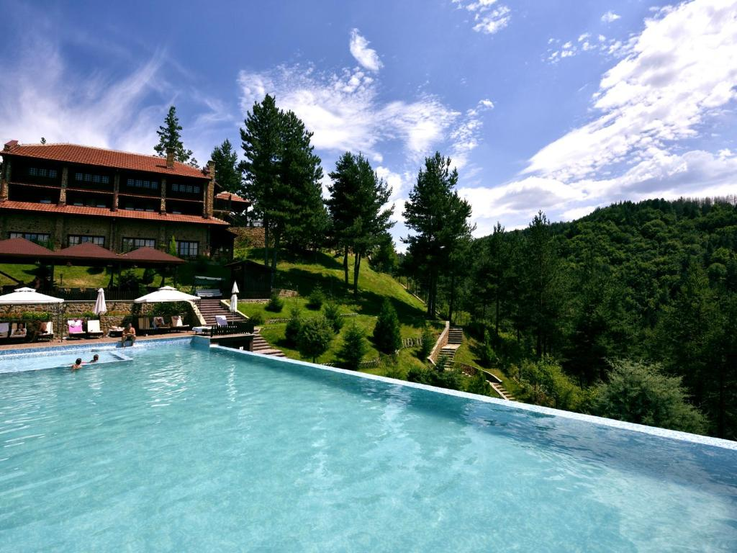
Tourism
St.John The Baptist – Kaneo, Ohrid Lake
Painted Mosque
Ski resort Popova Sapka
Spa & Wellness , Berovo
Notes:
The abundance of natural and cultural attractions makes this country suitable for tourism.
Located at the crossroad of civilization we can freely call it the Cradle of culture, the Land of nature.
On this small piece of land, you can find remains from prehistory, from the time of Alexander the Great, Roman times – The Byzantine Empire, and Ottoman Empire.
The famous Via Egnatia road passes trough Macedonia and was constructed in the 2 century B.C. by the Romans.
In the same place, you can visit churches from early Christianity time, and mosques from Ottoman time.
Afterwards, you can enjoy swimming in our beautiful lakes, or relax at a Spa center.

Slide 17
Investment Incentives
up to 50%
New Jobs
Investment Project of Significant Economic Interest
R&D Center and Activities
Capital Investments
Acquisition of Companies with difficulties
Growth of Market Competitiveness
Balanced Regional Development
I N C E N T I V E S
+ 50 % of the total justified costs
for industrial research
Notes:
Productive Initial Investments aimed at increasing the competitiveness of the economy and employment can be subsidized up to 50%
Investment incentives can be awarded for: читај ги мерките

Slide 18
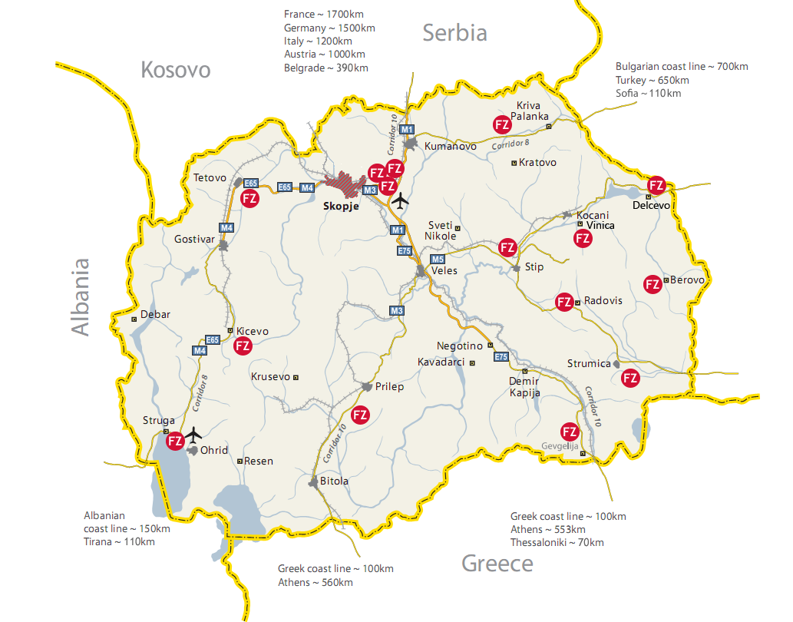
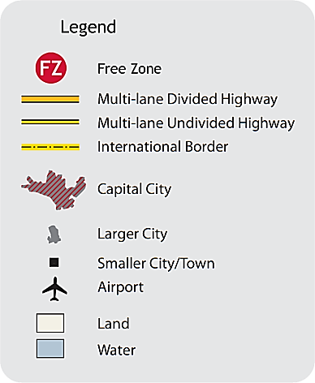
Technological Industrial Development Zones - TIDZs
Free Zone Rankovce
Area Size: 40 ha;
Corridor 8
Free Zones Skopje 1, 2,3
Area Size: 145 + 95 + 44 ha;
E-75 Highway;
Next to the Int’l Airport
Bulgaria
Free Zone Tetovo (PPP)
Area Size: 95 ha;
Distance from Skopje - 35 km
Free Zones:
Delcevo: 21 ha;
Vinica: 26 ha;
Berovo: 17 ha;
Free Zone Prilep
Area Size: 68 ha;
Between Prilep and Bitola (4th and 2nd largest city)
Free Zone Radovis
Area Size: 10 ha;
Free Zone Stip
Area Size: 208 ha;
The largest Free Zone;
Free Zone Kicevo
Area Size: 30 ha
Free Zone Gevgelija
Area Size: 50 ha;
85 km from the port of Thessaloniki
Free Zone Strumica
Area Size: 23 ha;
Free Zone Struga
Area Size: 30 ha;
Next to the Int’l Airport;
170 km from Durres port
Notes:
We have specially designed, already set up locations all across the country, which offer unique opportunities to invest in technologically advanced production.

Slide 19
Free Zones and Fiscal Benefits
TAX | TAX RATES
 | TIDZs | Outside TIDZs
Corporate tax | 0% for the first 10 years | 10%
Personal income tax | 0% for the first 10 years | 10% - 18%
Value added tax | 0% | 18%
Property tax | 0% | 0.1% - 0.2%
Excise taxes | 0% | 5% - 62%
10 year tax holiday
Land in the TIDZ is available under long-term lease for a period of up to 99 years
Free connection to natural gas, water and sewage network
10% return of investment cost
All incentives are in line with EU regulations
PRODUCT | CUSTOMS DUTY
 | TIDZs | Outside TIDZs
Raw materials | 0% | Up to 15%
Equipment | 0% | 5% - 20%
No customs duties & No VAT on imported equipment & construction materials
Notes:
At free economic zone you can benefit from:
10 year tax holiday
Land in the TIDZ is available under long-term lease for a period of up to 99 years
Exempt of paying utility taxes
Free connection to natural gas, water and sewage network
At least 10% return of investment cost
No customs duties & No VAT on imported equipment & construction materials
Worth to mention that all incentives are in line with EU regulations.

Slide 20
Key investors
Notes:
Many respected world-known companies recognized the investment opportunities and are already present in the country.
Just to name a few: Johnson Matthay, Kostal, Gerresheimer, Marquart, Dura, Van Hool, Magna and many more.

Slide 21
Export Promotion
Supporting participation at the international business events (fairs, trade missions and B2B meetings)
Specialized training, market research
Organizing meetings with domestic companies
Generating information and contacts of domestic producers
Free of charge registration to the matchmaking platform our website: https://export.investnorthmacedonia.gov.mk/
Notes:
Our export promotion activities aimed to :
support….
Our Export promotion Department – Export promotion services involve training, market research, organizing direct meetings, helping our clients to participate in trade fairs, organizing trade missions, B2B meetings, and other activities related to export growth.

Slide 22
AGENCY
FOR FOREIGN INVESTMENTS AND EXPORT PROMOTION
Thank You!
Тeşekkür ederim!
www.invest.gov.mk
Nikola Vapcarov 7
1000, Skopje Republic of North Macedonia
Tel.: + 389 2 3169 100
fdi@invest.gov.mk
November 208

Slide 24
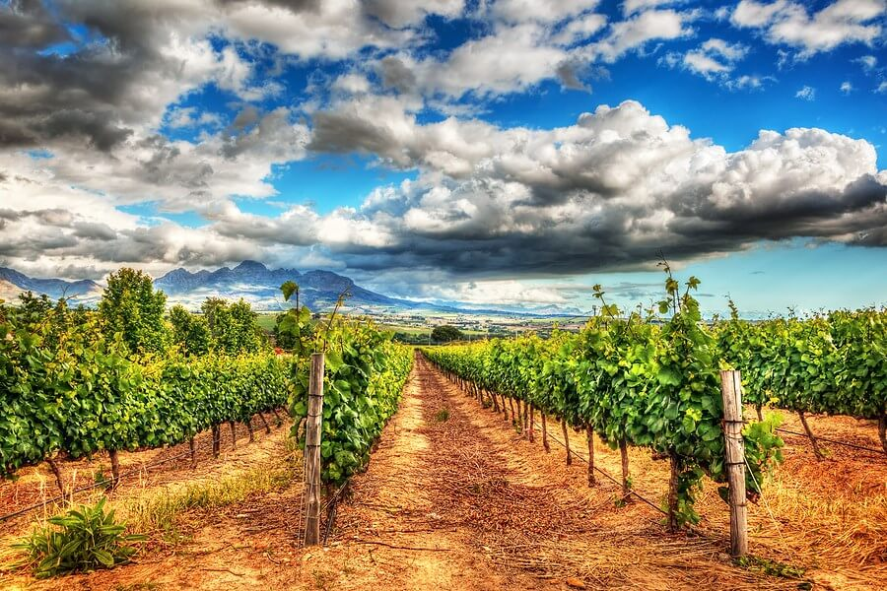
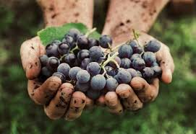
Wine Industry
Total vineyard area 33,423ha (85% wine varieties / 15% table grapes)
Vineyard area under wine varieties: 28,213ha
Harvest: Up to 125K tones of grapes, from grape growers and wineries' own vineyards
More than 90 million liters wine per year
40% produced as bottled wine; 60% sold in bulk
Examples of wine regions that have a Mediterranean-Continental climate include parts of California, the Rhone Valley in France, and parts of Spain and Italy.
Top 5 importers of Macedonian wine in 2022 : Serbia (€ 14.9M), Germany (€ 9.9M), Croatia (€ 9.7M),
BiH (€ 4.53M), and Bulgaria (€ 3.53M).
Notes:
Please, try our wines. I believe that you will be delighted.
Wine is embedded in the nation’s culture and folklore, and is mentioned in many folk songs, stories, legends, and traditions.
Wine Production is reaching nearly 91 million liters and out of this 40% are produced as bottled wine and 60% are sold in bulk.
85% of the SALES OF WINE in 2020 are exported to 37 countries worldwide

Slide 25
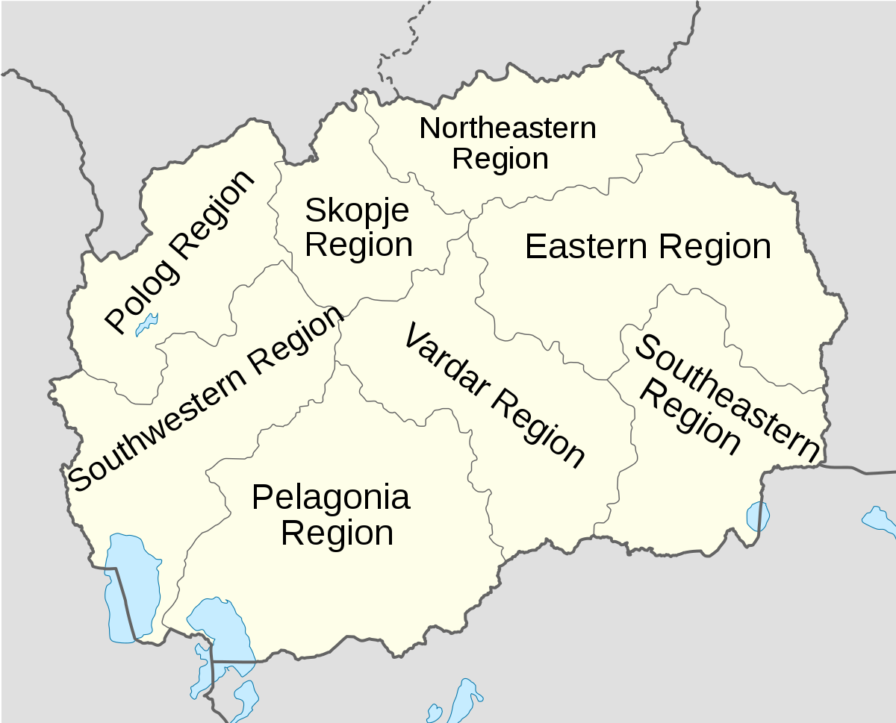
Additional Financial Support
BALANCED REGIONAL DEVELOPMENT
For the purpose of contributing to Balanced Regional Development, the beneficiaries of financial support shall be granted with additional financial support depending on the planning region where the production investment is implemented.
Notes:
For the purpose of contributing to Balanced Regional Development, the beneficiaries of financial support shall be granted with additional financial support depending on the planning region where the production investment is implemented.
(Ne mora) The last available data on GDP per capita per region announced by the State Statistical Office of the Republic of North Macedonia shall be used to calculate the additional financial support.

